Slide 1
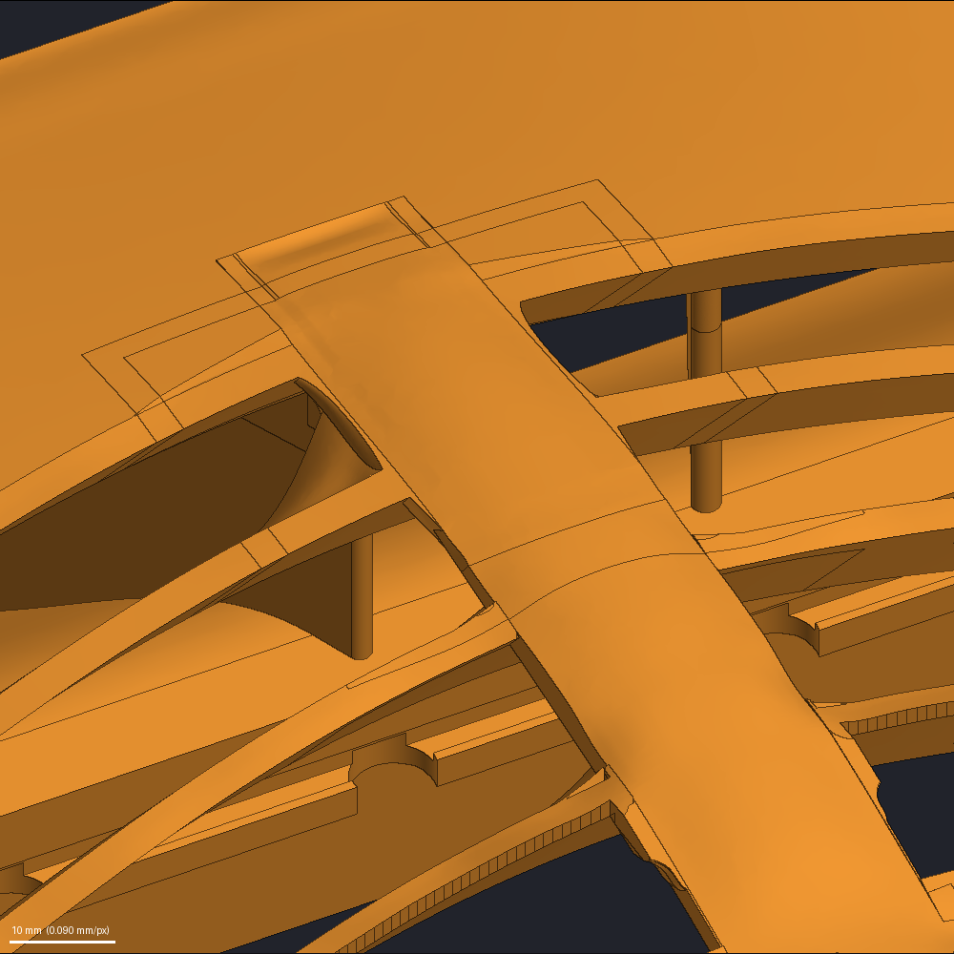
Full Section Rework
How one section of a solid model is rebuilt, step by step
Worked example: section 4 under the spine of a housing
2026-10-30
The rebuilt section in a trial copy of the housing, seen from the front and above.

Slide 2
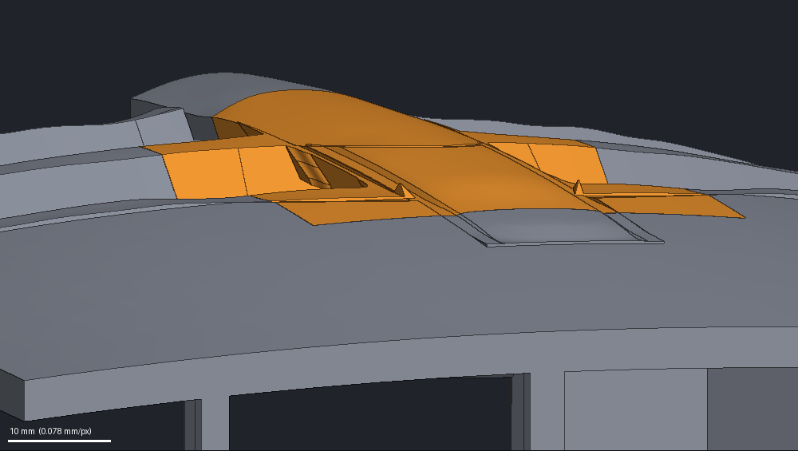
What the Full Section Rework Does
A summary of the process in plain words
IN SHORT
The Full Section Rework replaces one section of a solid CAD model. It cuts the section out, rebuilds its surface from a small number of clean faces, and sews the new section back into the body exactly where the old one was. Nothing outside the section changes.
WHY IT IS NEEDED
Earlier edits left some sections of the housing model as many small, uneven faces. They look sloppy, and further edits on them fail.
HOW IT WORKS
Cut the section out of the body with flat walls.
Decide which original faces stay, and group them into features; each feature becomes one face.
Draw a wireframe: one simple curve for each border, plus lines that shape the new surfaces.
Build a surface for each face and sew them into one closed solid that ends exactly on the body's cut faces.
Try the new section in a copy of the whole body, check it from every side, and accept it only when the pictures pass.
WHO DOES WHAT
The agent, an AI model working through the CAD kit, makes the design decisions. The kit, a set of scripted CAD steps, builds, draws its pictures, checks, and refuses any result that breaks a rule. Two reviewers, separate AI agents, check the trial's pictures. The owner of the part sets the goals and accepts the result.
THIS EXAMPLE
Section 4 under the spine of the housing. The housing is mirror-symmetric left to right, and the rework keeps it so: the agent works on one side and the kit mirrors the work to the other. The design goals: much more material between the vanes and the spine, a hairline slit between the plate and vane 2 closed by a lid on a line the owner drew, and a slit under the crown filled.
The section to rework (orange) in its place in the body (gray); the flat walls run where orange meets gray.

Slide 3
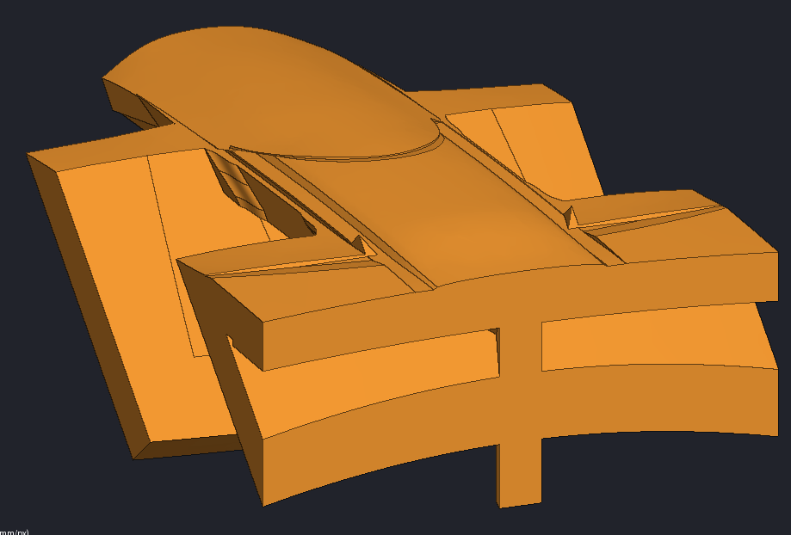
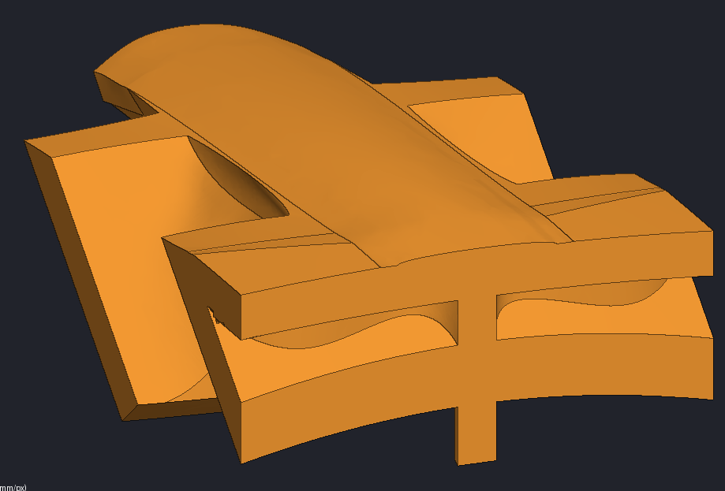
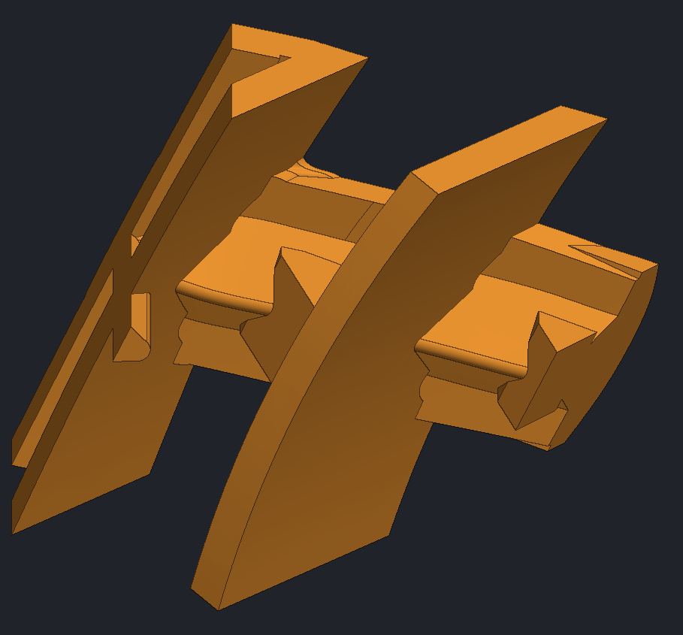
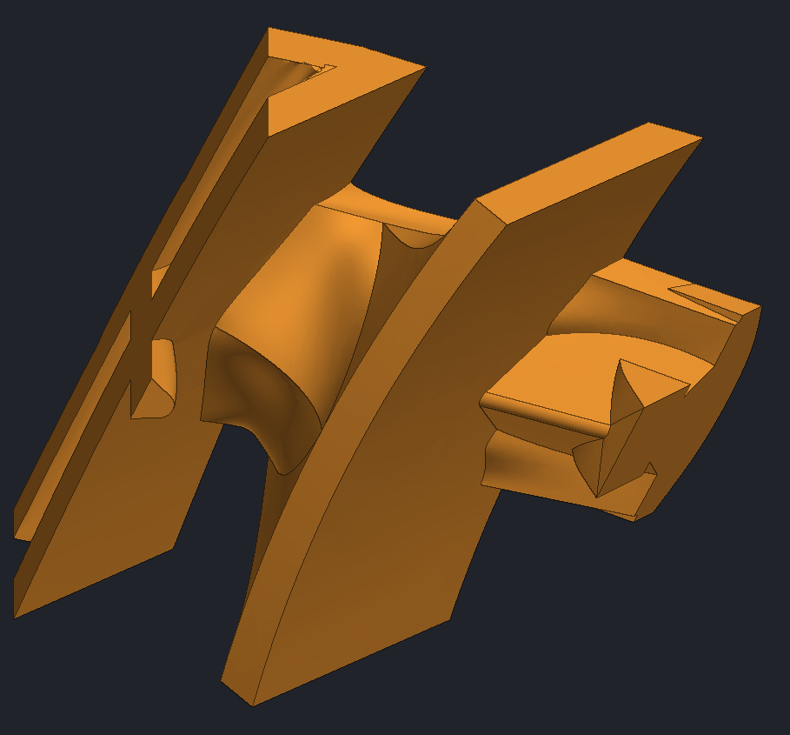
Before and After
The same section of the housing model before and after the rework, seen from the same two cameras
WHAT CHANGED
The slot under the spine is filled, and new flared sides join the spine to vane 1.
The hairline slit between the plate and vane 2 is closed by a lid. The slot behind the lid stays open.
The slit under the crown is filled.
The section's 142 faces became 50.
Outside the section, nothing changed.
BEFORE
AFTER
Before, from above: the spine's top steps down from a domed crown to a lower strip, with slits and pockets beside it.
After, same camera: one smooth spine top, with curved fills joining it to the vanes.
Before, from below: stepped blocks under the spine, with sharp notches between the vanes.
After, same camera: curved fills now sit under the spine where the stepped blocks were; some of their edges are still uneven.

Slide 4
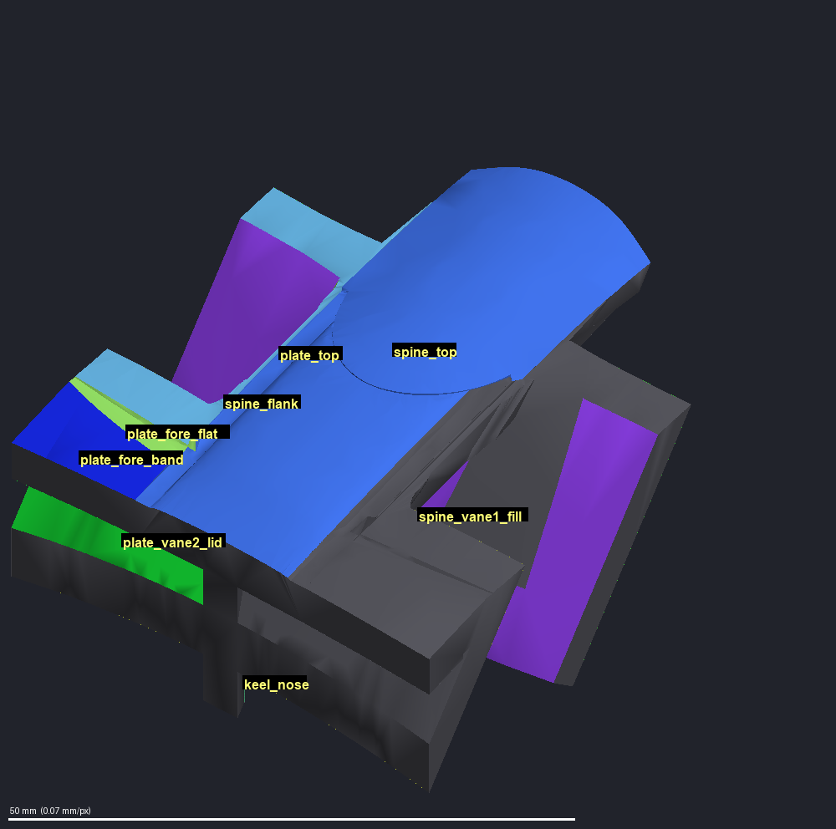
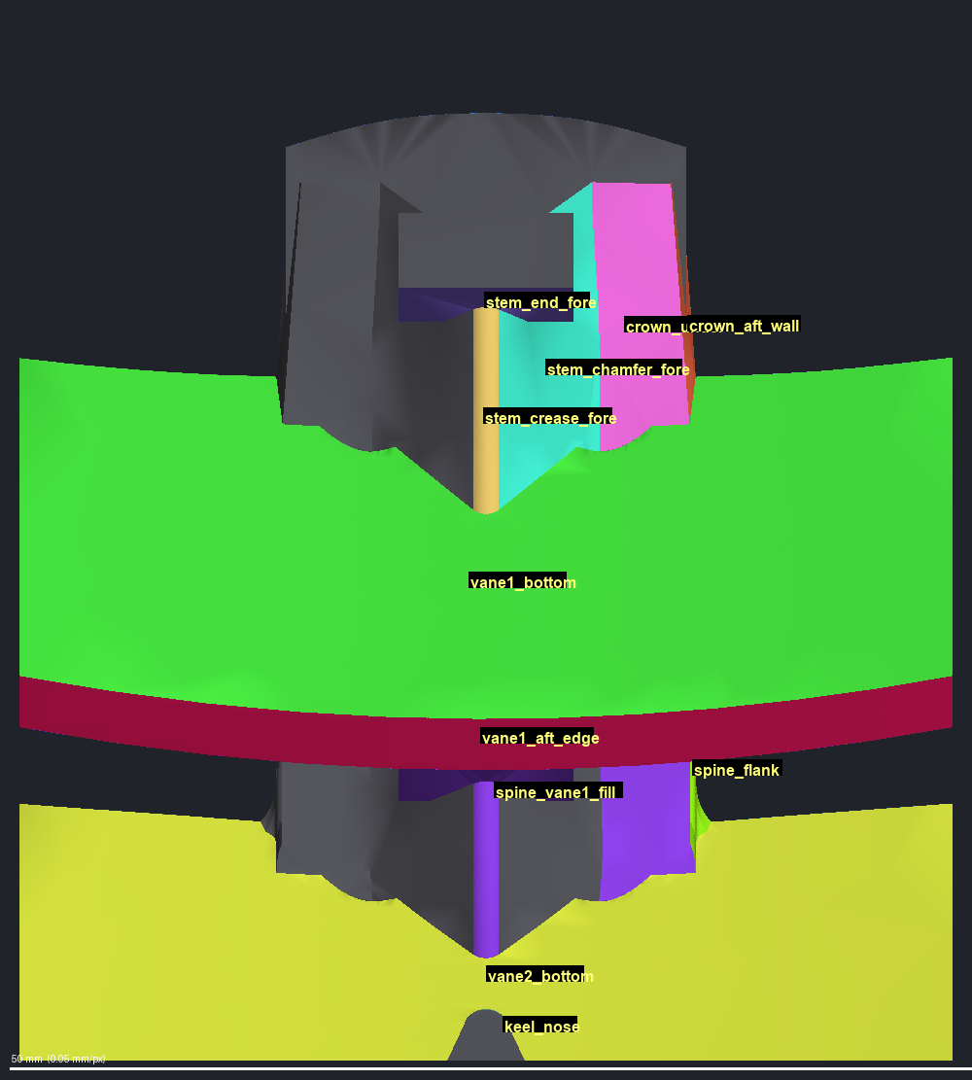
The Parts of the Section
The names used in this deck, placed where the kit itself names each part
stem, front end
crown
stem chamfer
stem crease
plate top
spine top
spine side
plate, front flat
vane 1 underside
plate, front band
pocket, spine to vane 1
lid area, plate to vane 2
vane 1 rear edge
spine side
pocket, spine to vane 1
keel nose
vane 2 underside
keel nose
From above. Each color is one feature; the gray parts are the mirror half and the wall cuts.
Straight up from below, the front at the top. Vane 1 and vane 2 cross under the spine.

Slide 5
The Steps at a Glance
Fourteen steps; at its gates the kit waits for the agent's verdict on the pictures
1 Cut the section out
flat walls; the body's cut faces kept as wall caps
2 Pick points
which original faces stay faces
3 Label faces
every triangle by its original face
4 Group into features
one face per feature per side
5 Lock the frame
faces end exactly on the walls
6 Mirror check
symmetric edits: every face has a partner
7 Edge network
junctions and chains
8 Draw the wireframe
wall corners numbered; one simple curve per border; split and guide lines
9 Preview the build
the surface ladder run on the wireframe
10 Build the piece
span every face, sew one closed solid
11 Look at the piece
rebuilt faces alone; the original against the piece
12 Mirror check
repeated on the built piece
13 Trial in the real body
sewn to the body along the cut
14 Review and accept
cuts through old and new; two reviewers; the owner accepts
HOW TO READ IT
Red boxes: the agent designs here: where the walls go, which points and features to keep, which lines to draw, whether each face is clean. Blue box: the owner decides. Gray boxes: the kit does the work, and the agent still judges the pictures.
Nothing is fixed by moving a surface by hand. A wrong shape is fixed upstream, in its points, its features or its lines, and the steps after it run again.
Most steps write pictures. At five gates (the cut, the layout, the wireframe, the built piece and the trial) the kit waits until the agent has recorded a verdict: ok, move or redo. Each set of pictures has its own colors; the captions give them.

Slide 6
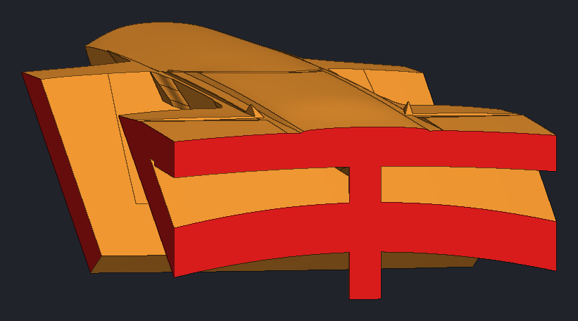
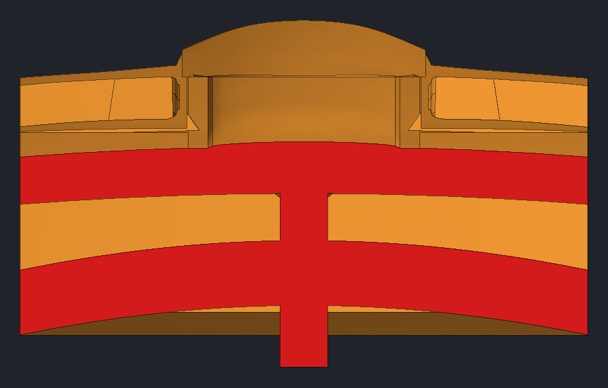
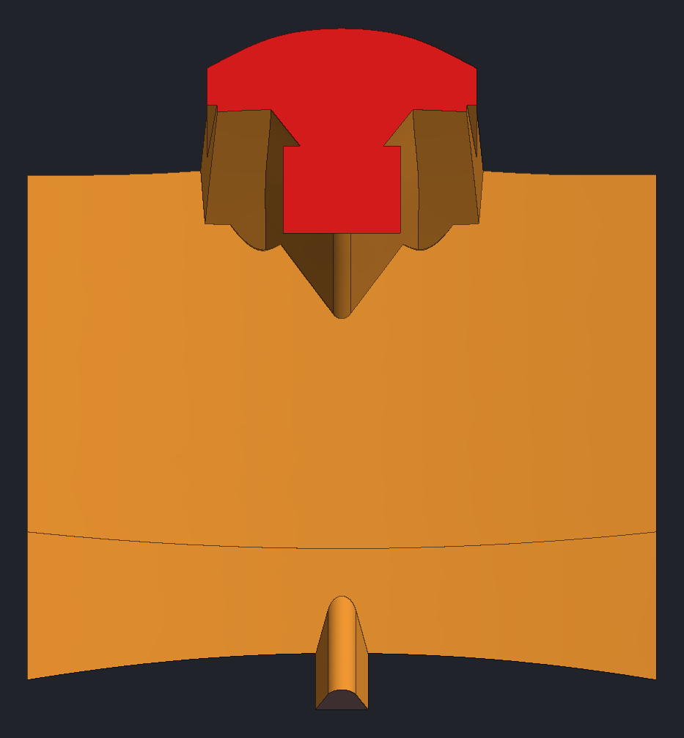
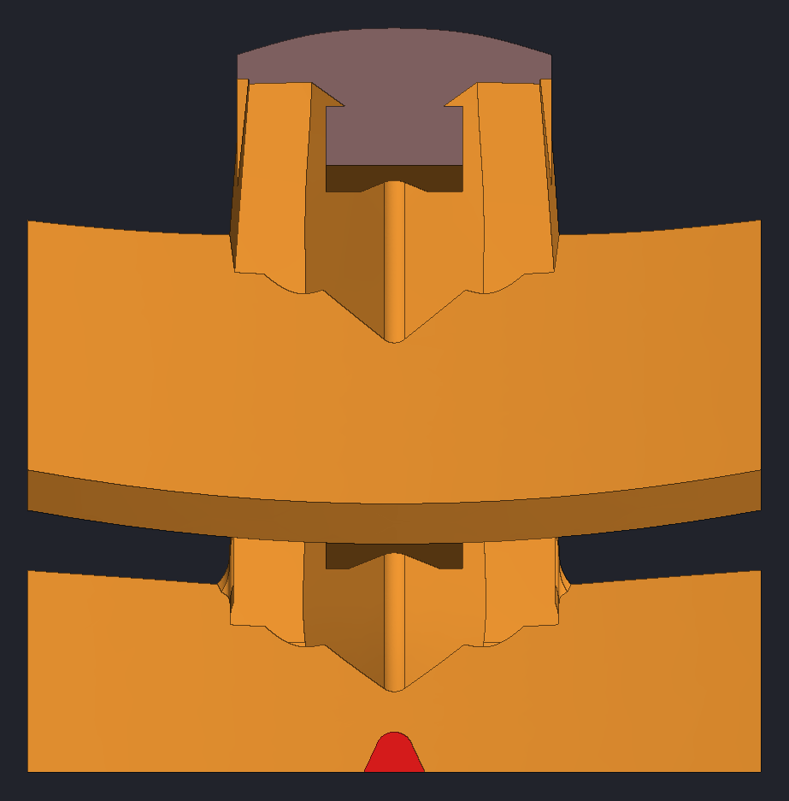
Step 1 – Cut the Section Out
Flat walls cut the section out of the body; nothing outside the walls is touched
WHAT IT DOES
Flat walls cut the section out of the body. Everything inside is rebuilt; everything outside stays exactly as it was.
Right after the cut, the kit keeps the body's own cut faces on each wall (the wall caps) and covers the section's original surface with a fine triangle mesh, each triangle tagged with the face it came from.
THE AGENT DECIDES
Where the walls go. A wall must cross the part through clean material: never along a surface, never through a thin lip or the feature being fixed.
THE KIT CHECKS
No other step runs until the agent has judged the cut pictures ok.
THIS EXAMPLE
Five walls: two side walls, a rear wall, a floor and a tilted front wall. They cut a box 48 mm wide, 54.5 mm long and 35 mm tall, with its front end cut off by the tilted wall.
The section: 12,416.4 mm³ in 142 faces: 7 cuts on the walls (the wall caps) and 135 pieces of 131 original faces; the walls split 4 of them in two.
The section on its own. Red faces are where the walls cut through solid material; orange is original surface.
The rear wall seen face-on: its cut (red) crosses two curved bands and the stem that joins them.
The front wall is tilted, though seen here face-on; its cut (red) is one solid slice through the thick spine block.
Seen from below, the floor wall cuts only the small red shape. The dull shape is the front wall's cut.

Slide 7
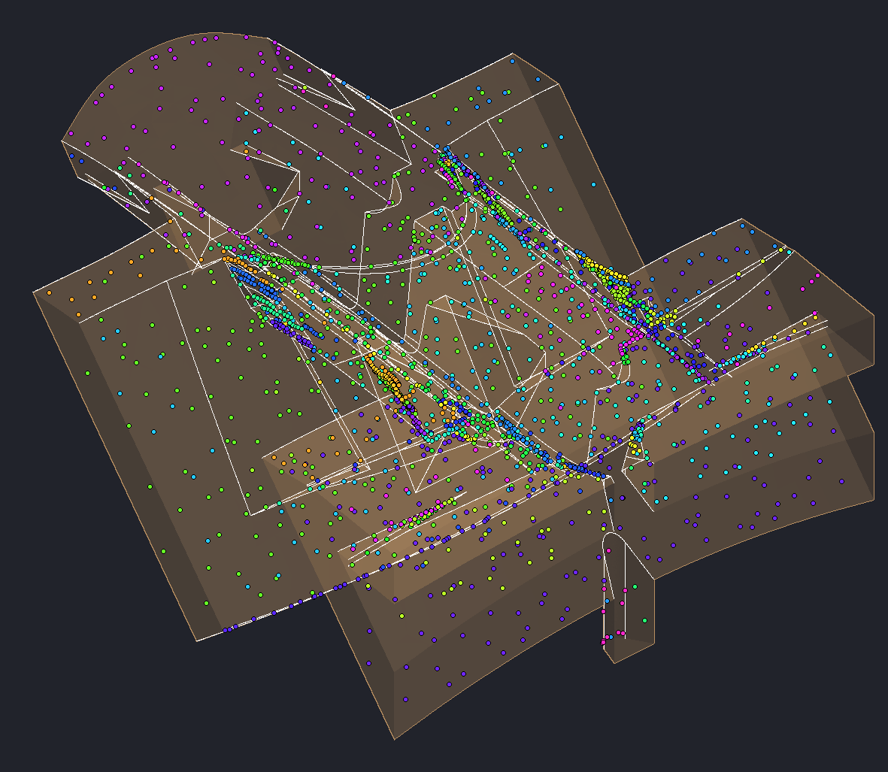
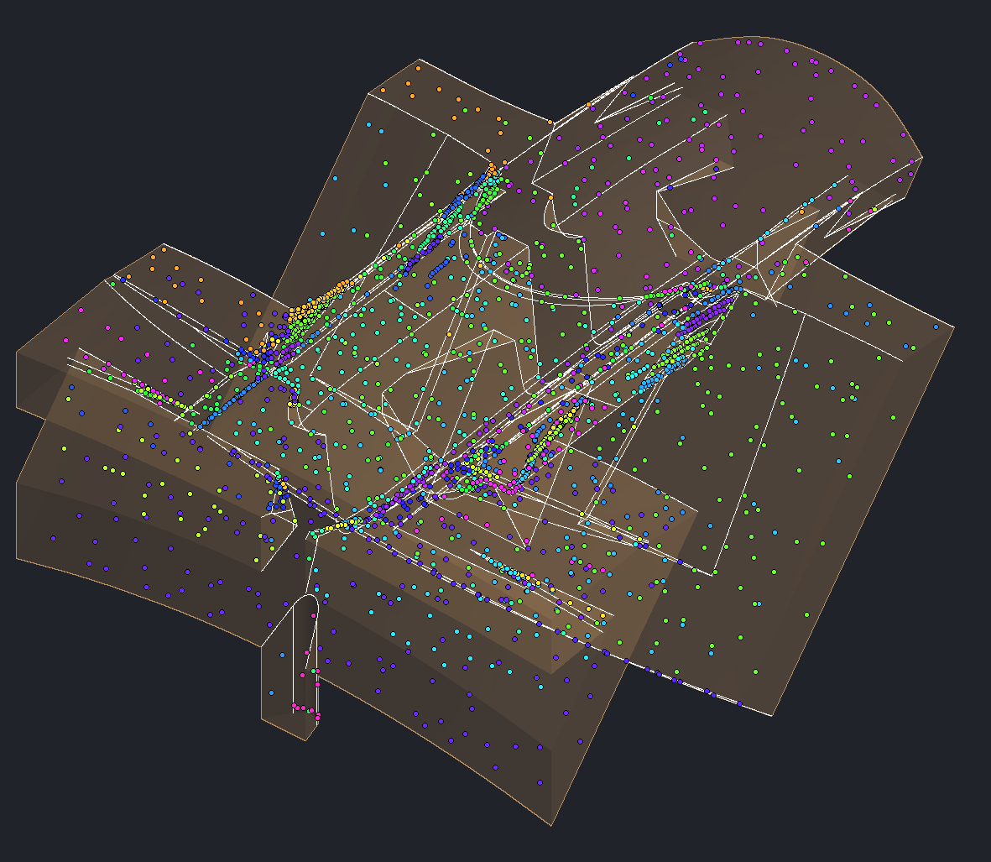
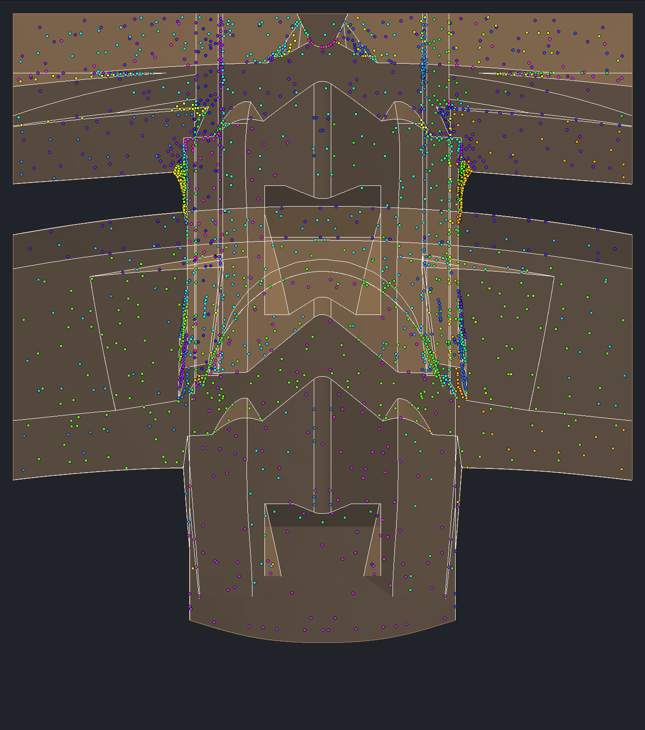
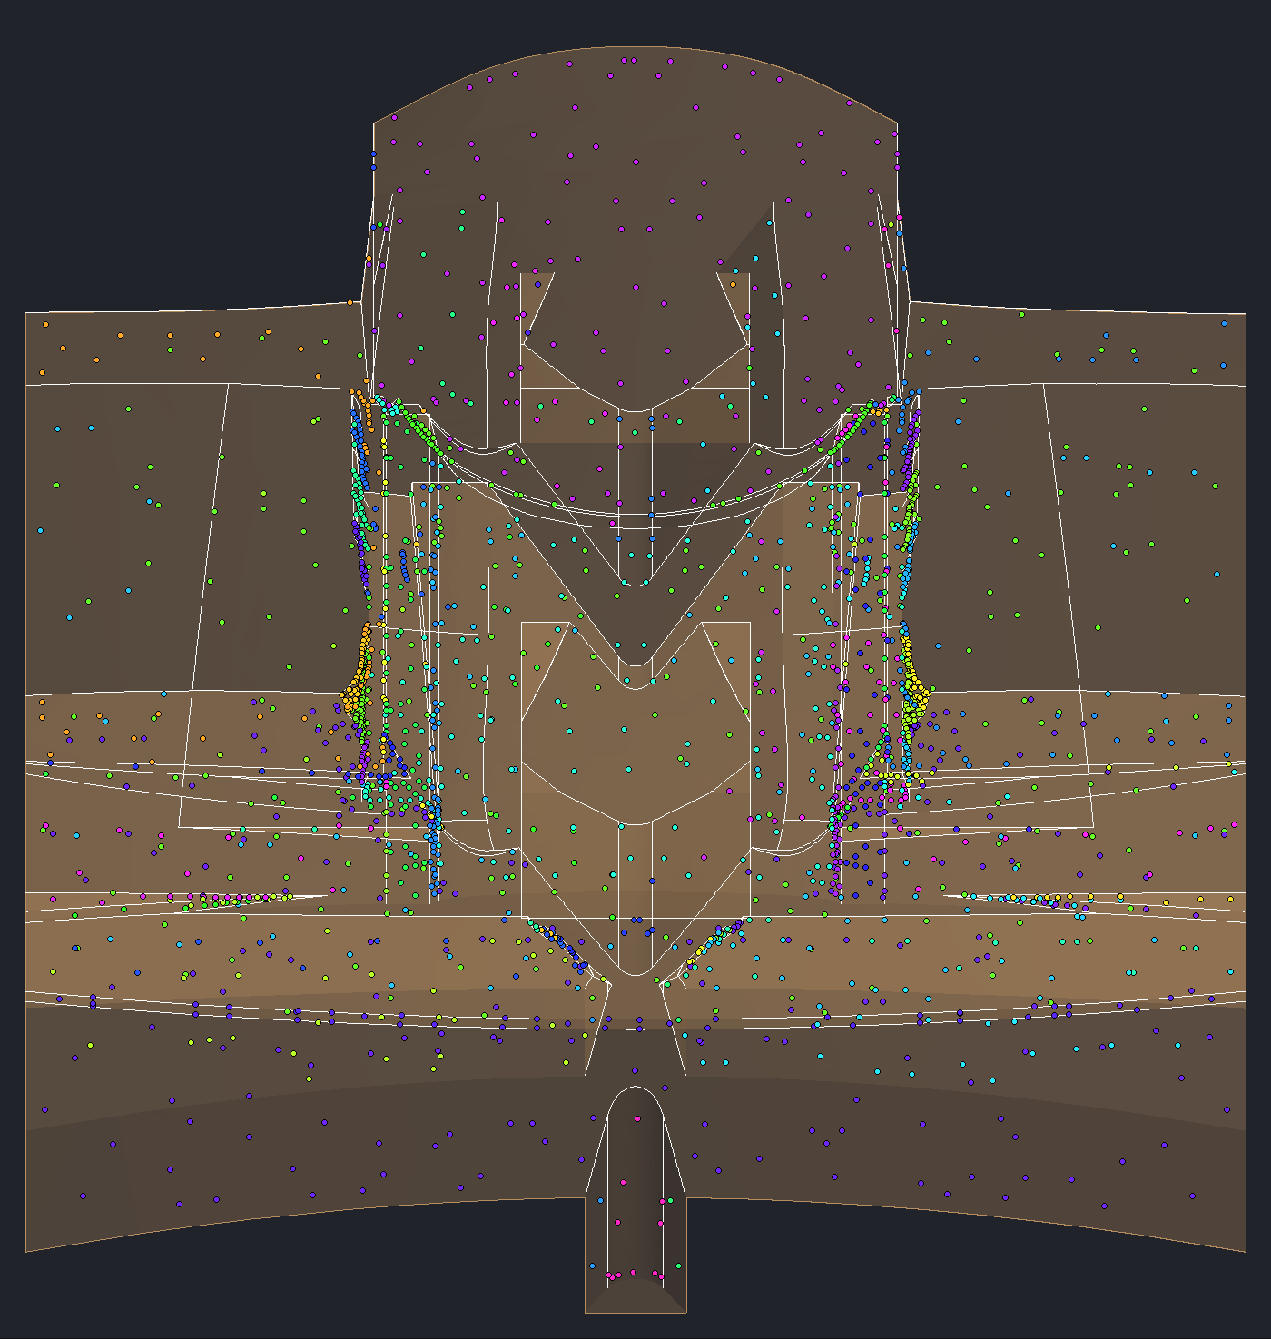
Step 2 – Pick the Points
Points on the original surface decide which original faces stay faces of their own
WHAT IT DOES
The kit spreads points over the section's original surface; each point belongs to the original face it lies on. A face that gets points stays a face of its own; a face with none is absorbed by its neighbors. Which faces keep their original surface is decided later.
THE AGENT DECIDES
Point boxes: a box adds dense points to keep small faces, or takes points out to drop faces on purpose. Every box carries its reason.
THE KIT CHECKS
The kit adds points beside every wall edge and rings in magenta any wall face still without one. A box without a reason is refused.
THIS EXAMPLE
2,316 points on the 131 original faces: 106 stay faces of their own and 25 are absorbed, both small slivers and seams and the faces of the slot under the spine, dropped on purpose so the slot is filled.
2,316 points on the original surface, each dot colored by the original face it lies on; white lines are the original edges.
From the other side: the dense rows beside the spine are the agent's point boxes, keeping every flat face on its sides.
Straight down through the see-through section: points sit on faces in every layer, not only on the top.
Looking along the spine: the domed spine top above the notched center column, dots on both sides alike.

Slide 8
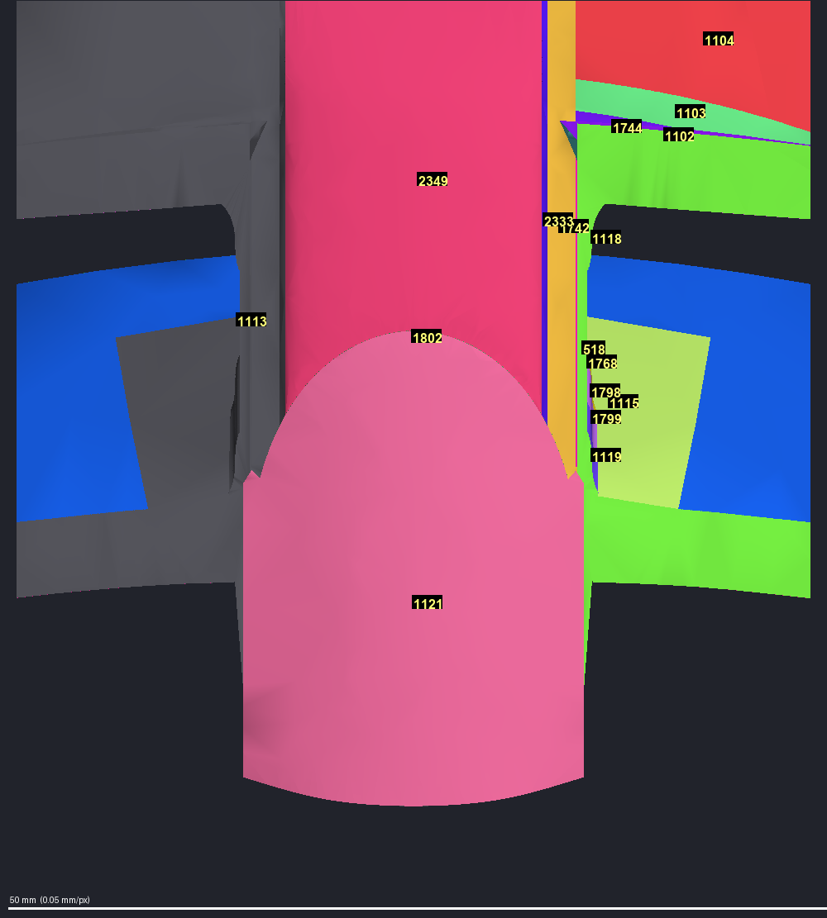
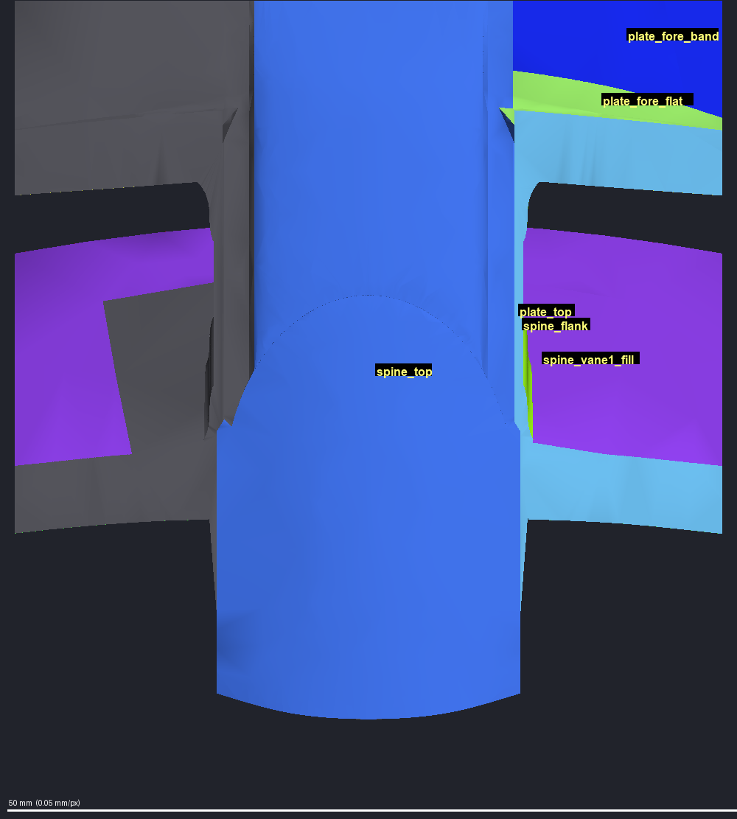
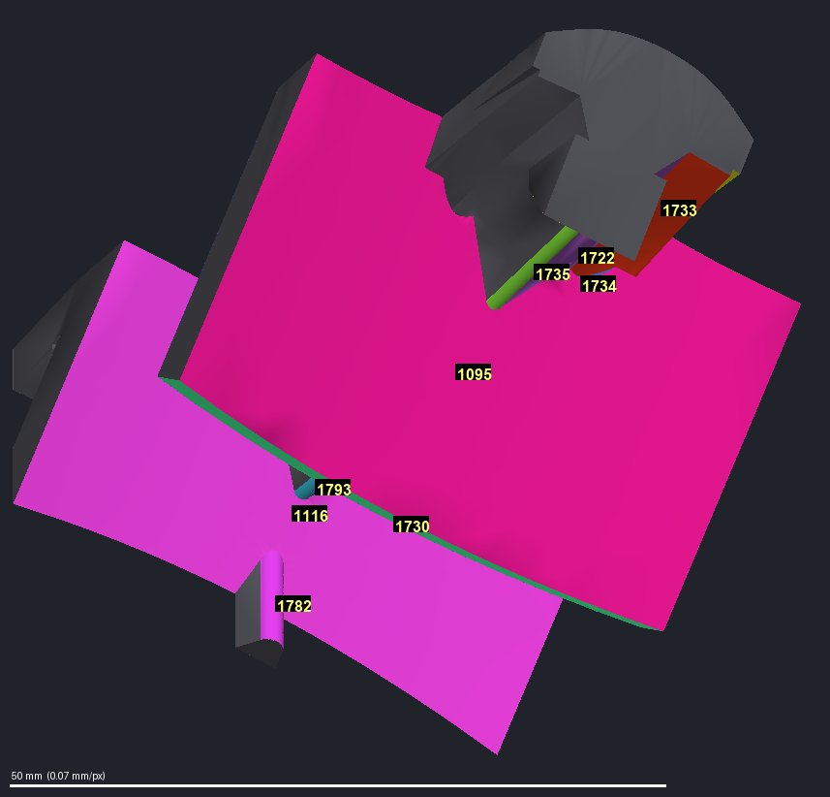
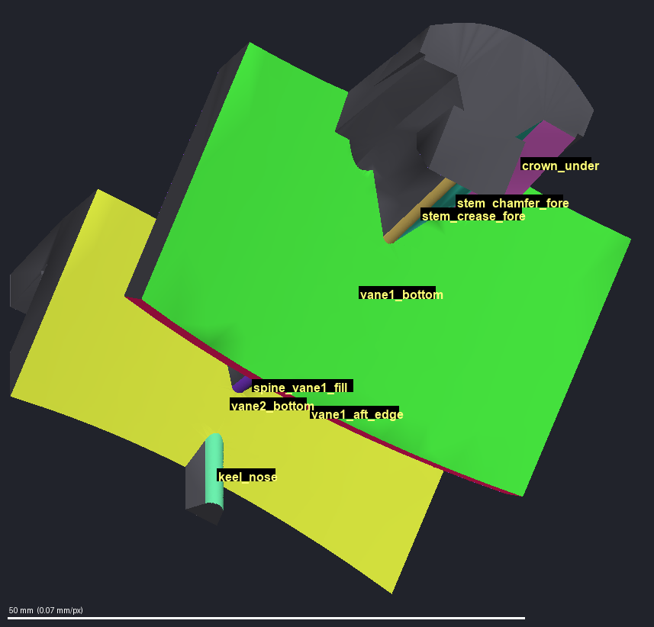
Steps 3 and 4 – Label the Faces, Then Group Them into Features
Borders start from the original model's edges on one side, mirrored to the other; the agent then says which faces are one feature
STEP 3 – LABEL
Every triangle of the section's mesh is labeled by the original face it came from. The pictures color one side; its mirror is drawn gray.
STEP 4 – FEATURES
The agent names the features, such as the spine top or vane 1's underside, and lists the original faces in each, with the reason. Faces of one feature become one face per side.
The kit refuses a feature map without its reasons.
THIS EXAMPLE
The label map has 103 patches: 96 on the surface and 7 wall caps.
21 features named. The kit then merges small faces and slivers into their neighbors.
One feature forms the lid that closes the hairline slit (see the example slide).
The layout: 37 faces, 30 on the surface (16 on the original surface, 14 rebuilt) and 7 wall caps.
Step 3, from above: each triangle takes the color and number of its original face. The gray half is the mirror side.
Step 4, same view: the numbered faces are grouped into features. The dome and the spine strip become one feature.
Step 3 from below: wide bands and thin slivers each keep their own color and number.
Step 4, same view: the bands become features, such as vane 1's underside and vane 2's underside.

Slide 9
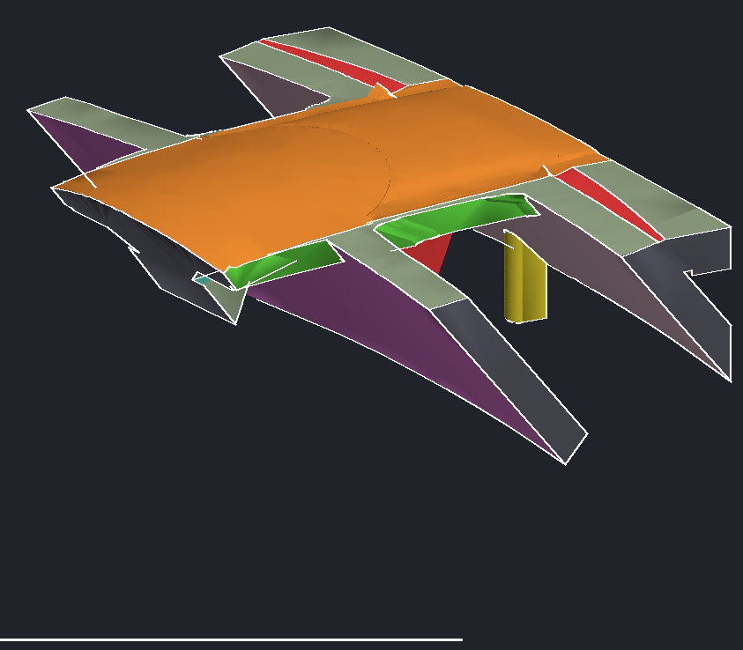
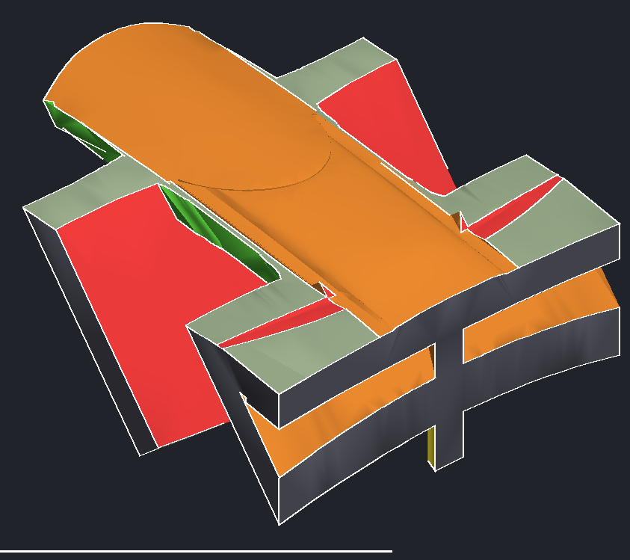
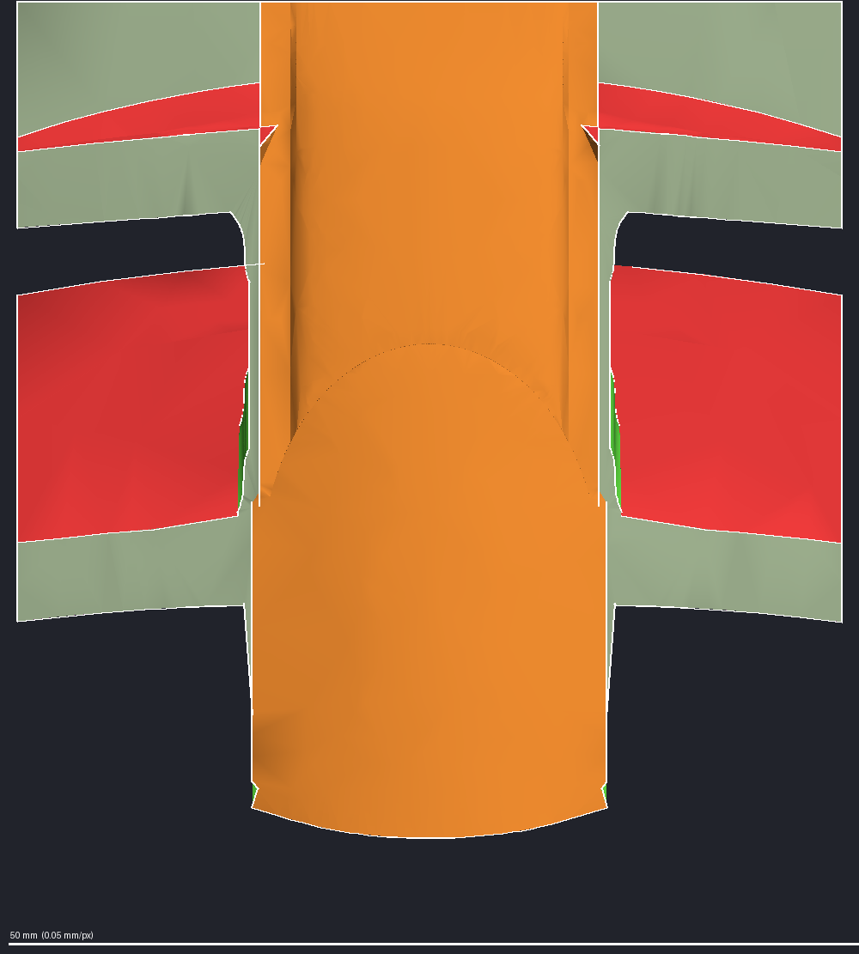
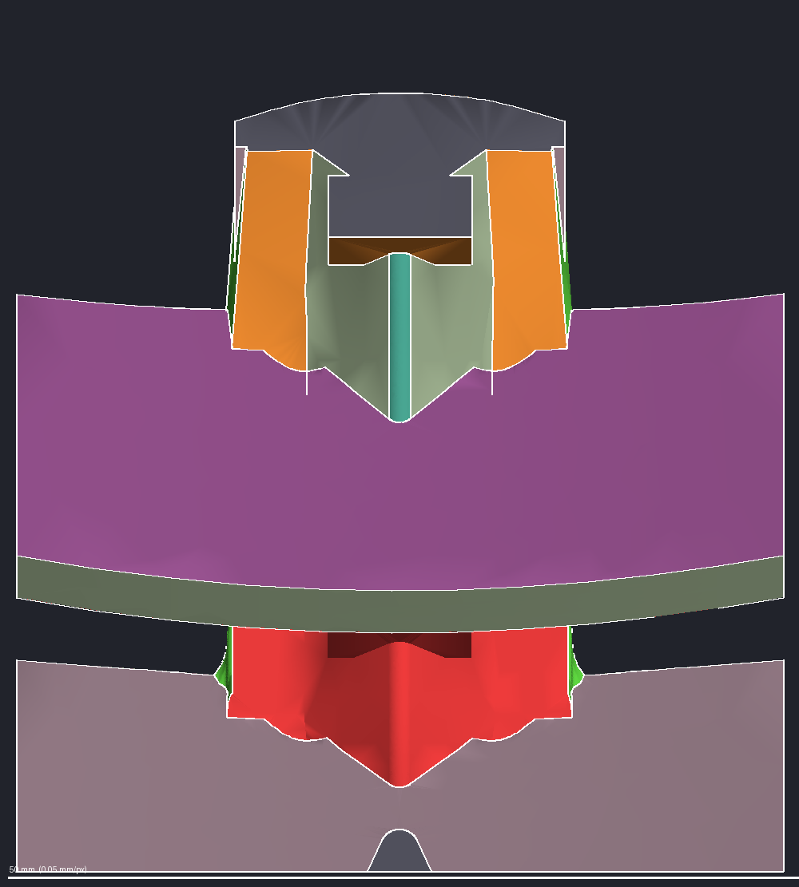
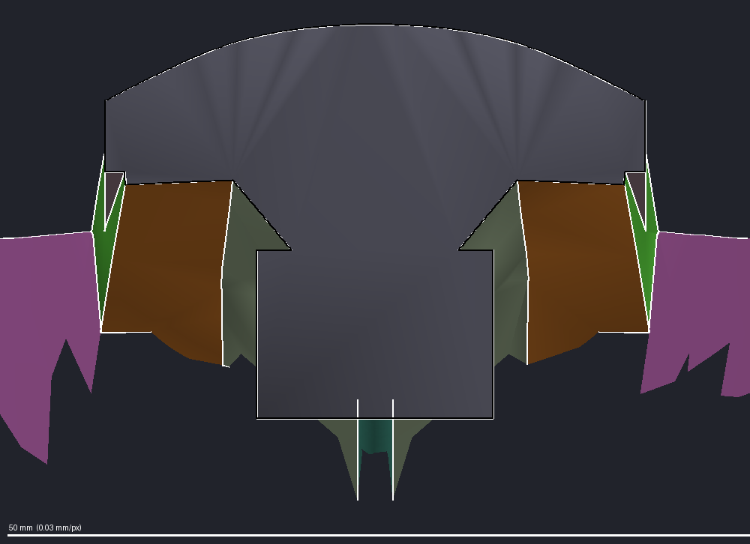
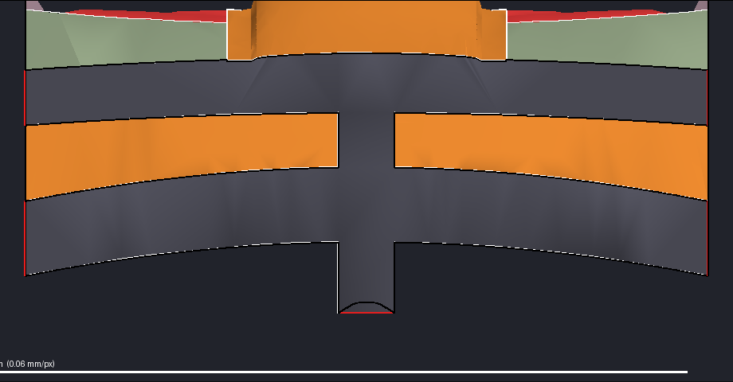
Step 5 – Lock the Frame at the Walls
Where the new surface meets the body, every face ends exactly on the body's own cut faces, edges and corners
WHAT IT DOES
The rim of every face is made to end on the body's own wall faces. This is what lets the rebuilt piece fit back with no step, no lip and no gap.
The wall caps themselves are the body's faces, kept exactly.
Inside the walls the layout is free: any border can be moved or redrawn later.
THE KIT CHECKS
A face left open at a wall is refused before any surface is built. The agent judges the layout pictures, from every side, before the next step runs.
The layout the build works from: 37 faces outlined in white. Mirror twins share a color; wall caps are gray.
From the other end: the dark gray faces are the wall caps, the body's own cut faces, kept exactly.
Straight down: the spine top is one face spanning the center. Faces left and right match in shape and color.
The rear wall face-on: the gray cap is the body's exact cut face; every surface face stops on its outline.
The front wall face-on: the faces beside the gray cap end on its edges, the same on both sides.
Straight up: faces match left and right. The red face also covers vane 1's top; step 8 splits off the new fill.

Slide 10
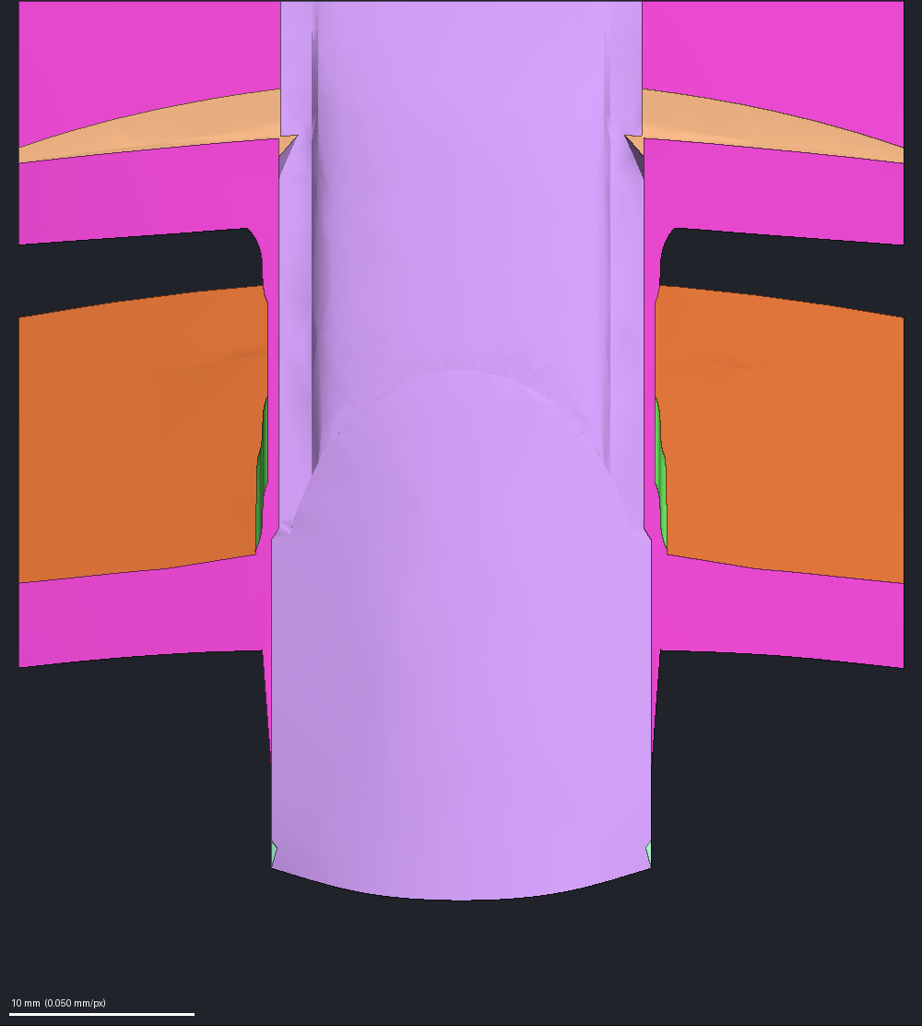
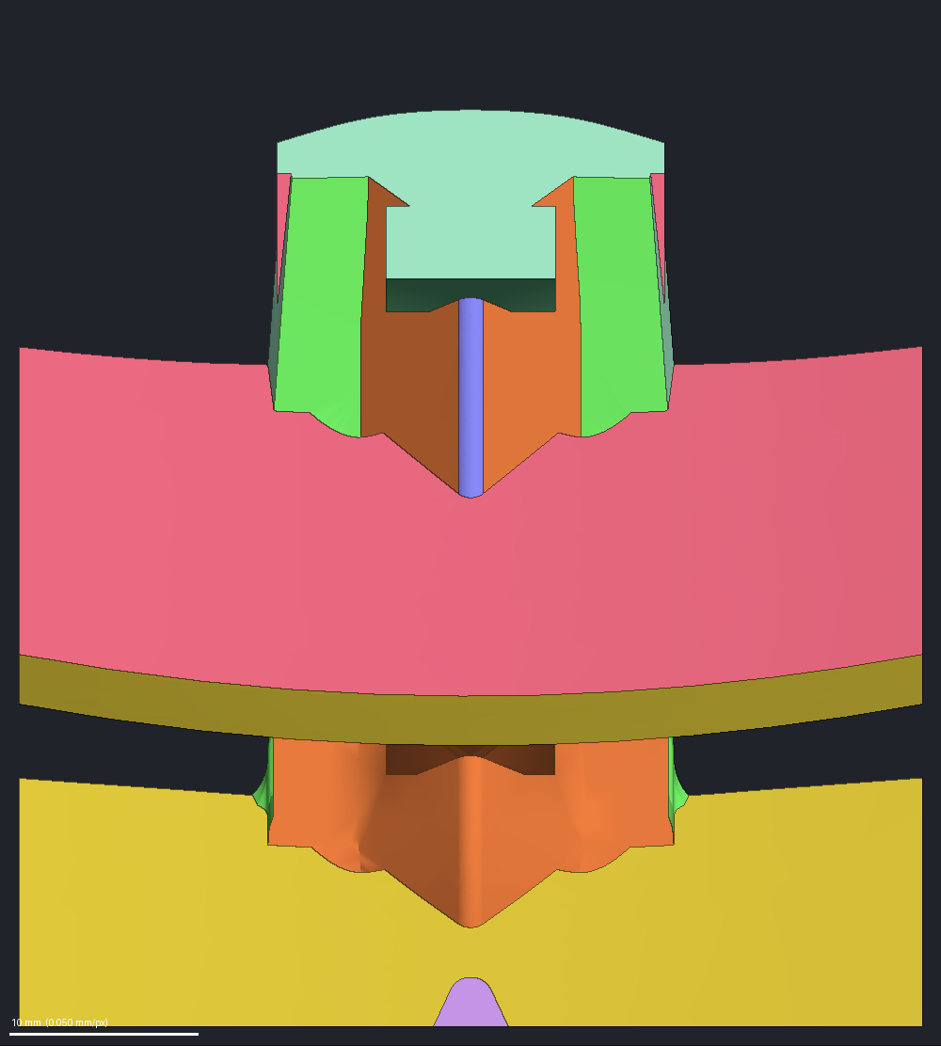
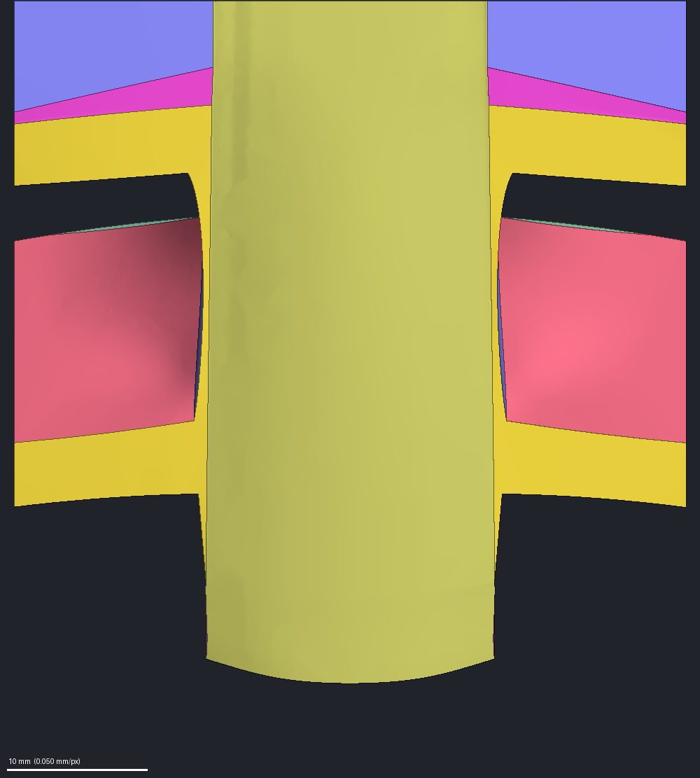
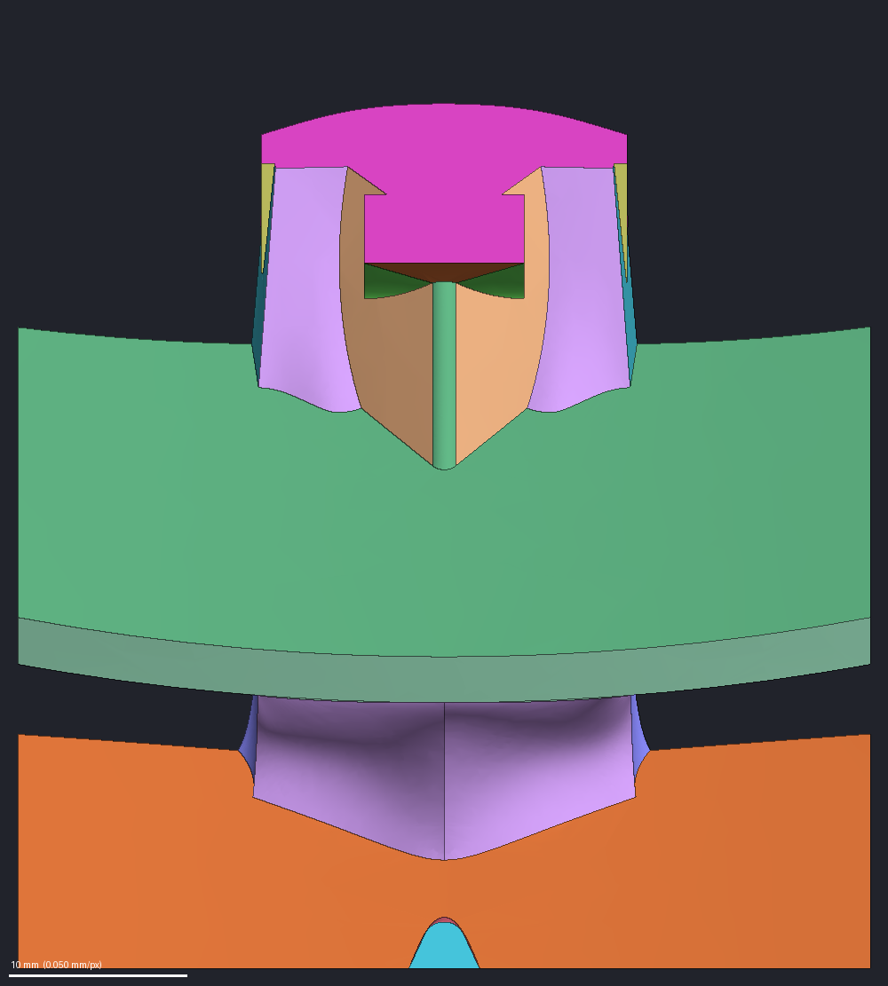
Steps 6 and 12 – Mirror Checks
On a symmetric edit like this one, every face must have a mirror partner, before and after the build
WHAT IT DOES
Each face is paired with the face on the other side whose reflected center lies within 1.5 mm, with an area within 35 percent and a mirrored direction. Each pair is drawn in one color on both sides; a face with no partner is drawn red.
A face that crosses the center line is its own partner.
The check runs only on an edit declared symmetric.
THIS EXAMPLE
Layout (step 6): 37 faces, 13 mirror pairs plus 11 faces on the center line. None without a partner.
Built piece (step 12): 50 faces, 20 pairs plus 10 on the center line. None without a partner.
THE KIT CHECKS
A face without a partner fails the check. The trial in the real body is refused until the piece passes.
Step 6, the layout from above: each face and its mirror twin share one color; no face is red.
From below: a face crossing the center line, like the wide pink band, is its own twin. Colors repeat across pairs.
Step 12, the built piece from above: twins share a color. The rose-pink faces are a pair, not unpaired red.
The built piece from below: twins match; the side light makes the left stem face look darker.

Slide 11
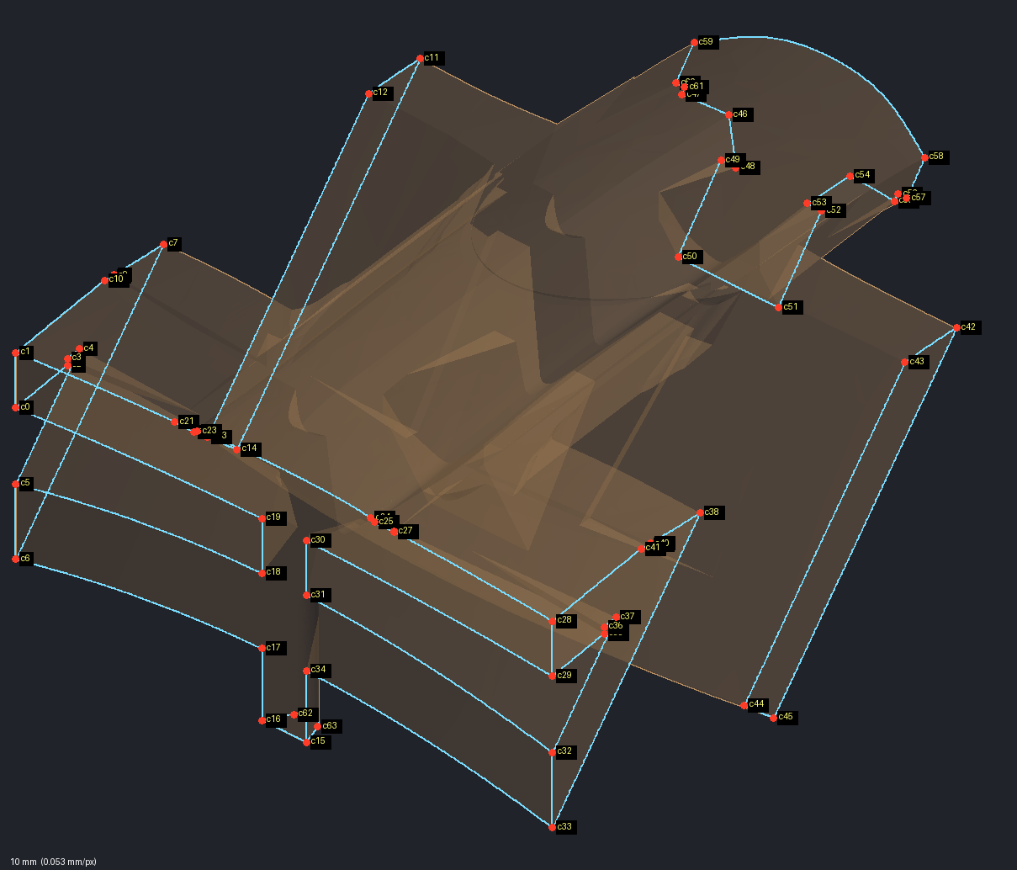
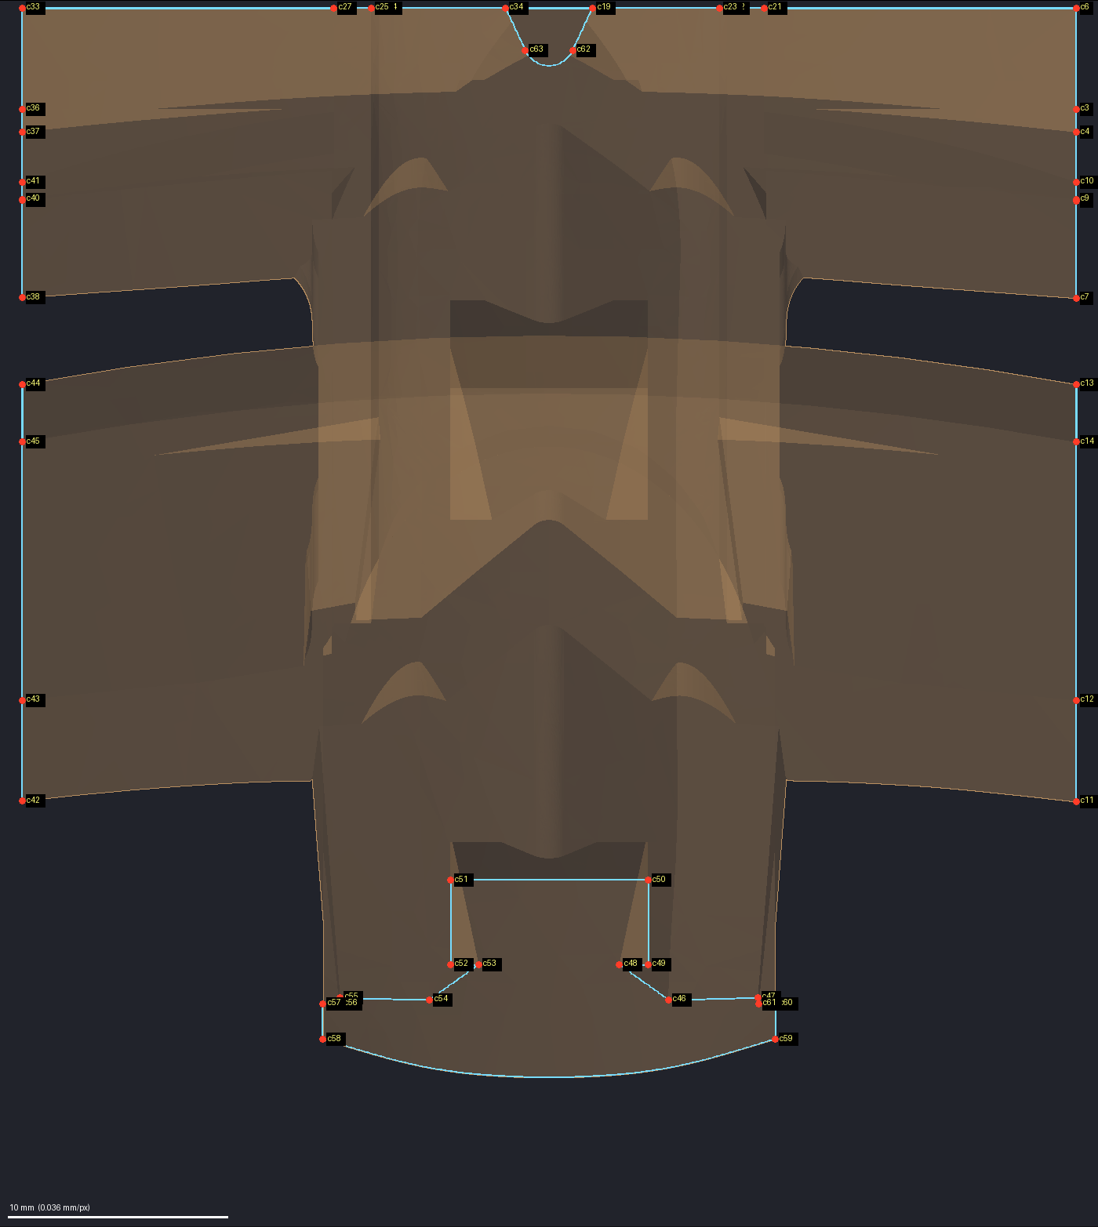
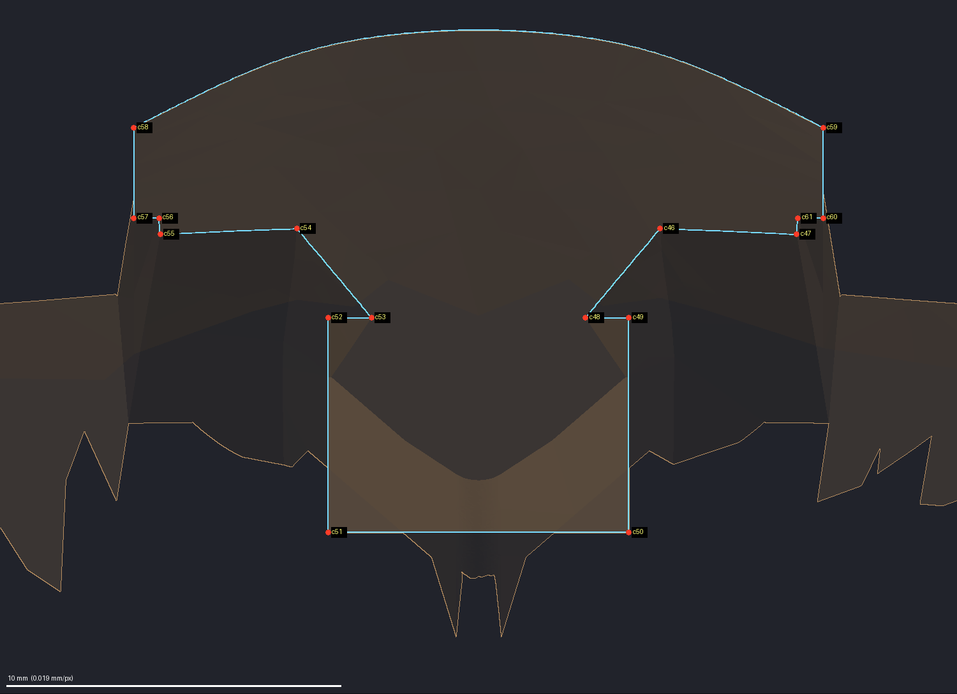
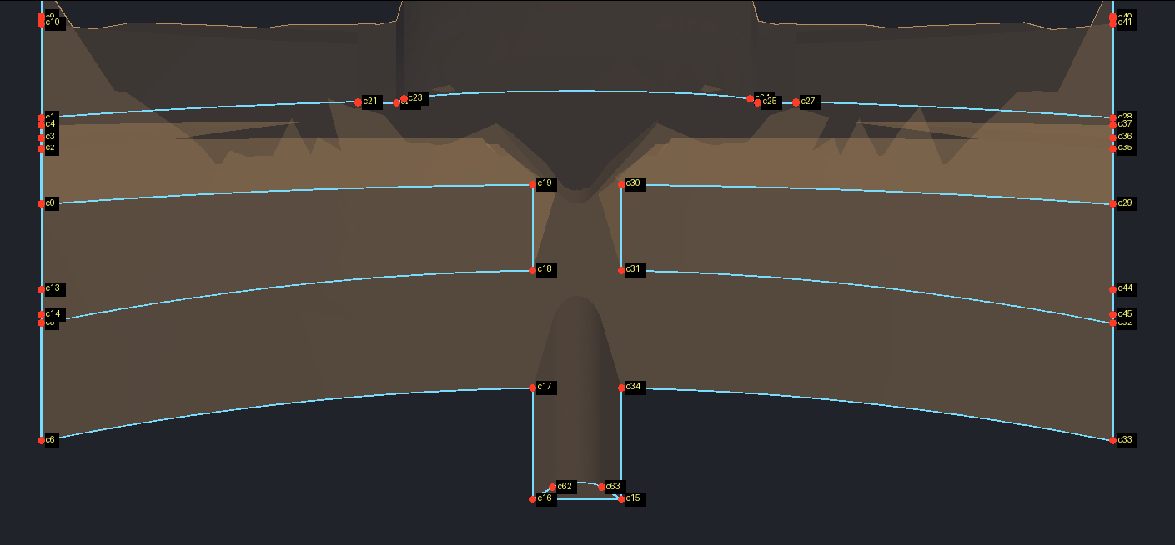
Step 7 – The Edge Network and the Wall Corners
Borders become chains and meeting points become junctions; the wall corners get numbers
WHAT IT DOES
The border between two faces becomes a chain; a point where three or more faces meet becomes a junction. Every corner on the walls is numbered, so a drawn line can end exactly on one.
The pictures show the wall corners, numbered as the wireframe step starts. The chains are drawn in the wireframe pictures that follow.
THIS EXAMPLE
103 chains (54 between surface faces, 49 along the wall caps), 68 junctions, 64 wall corners.
WHY IT MATTERS
A split line that reaches a wall must end on a numbered corner; that keeps the frame exact. A split line that ends anywhere else on a wall is refused.
The section seen through: cyan outlines the body's cut faces on the walls; red dots mark their numbered corners.
Straight down: the side walls show edge-on as straight lines, with their corners down both sides.
The rear wall face-on: corners come in left-right mirror pairs. Lines that reach a wall end on corners like these.
The front wall face-on: one cut face, a domed cap on a stem, with 16 corners in mirror pairs.

Slide 12
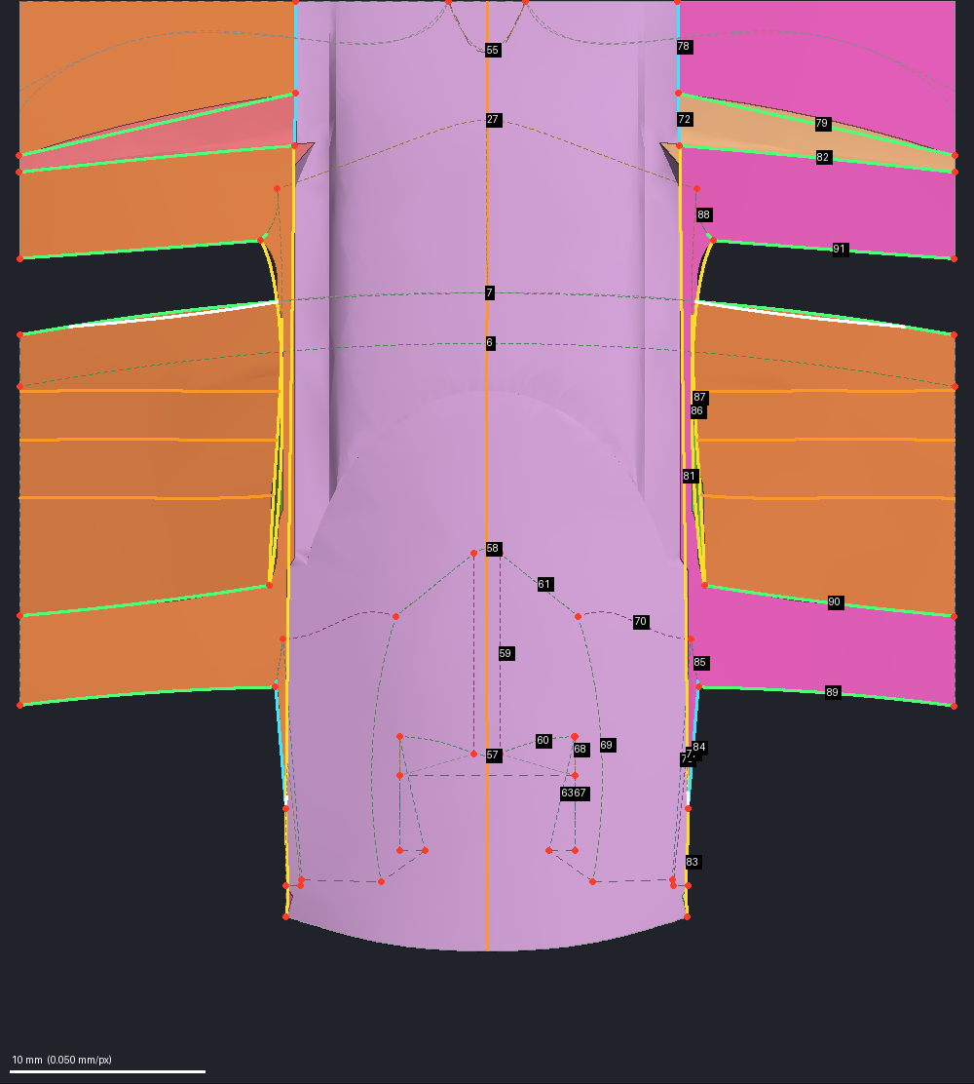
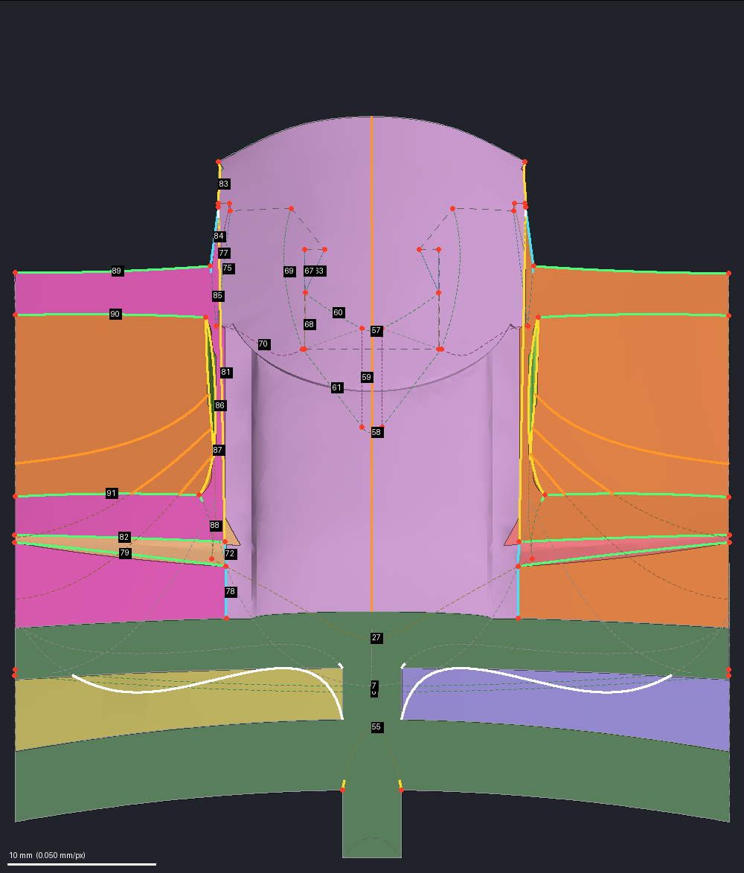
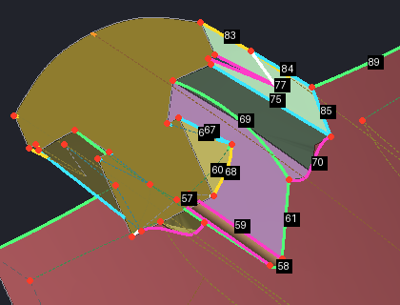
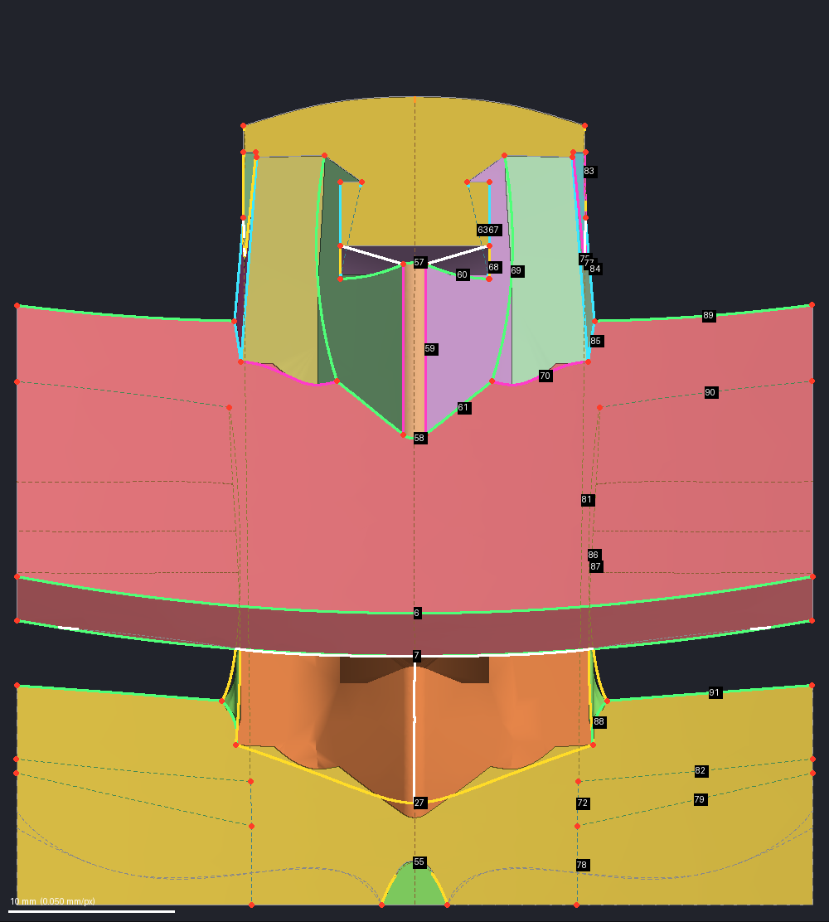
Step 8 – Draw the Wireframe: One Simple Curve per Border
Every border between two surface faces is replaced by the simplest curve that fits it
WHAT IT DOES
Each border between surface faces is replaced by the simplest curve that fits: a straight line, an arc or a cubic. The borders along the walls keep the body's own edges. Simple borders give simple surfaces.
THE AGENT DECIDES
The curve type of any border it chooses to set, each with its reason; the kit sets the rest.
THIS EXAMPLE
Of the 103 chains, 49 lie on the walls. The other 54 borders: 14 straight lines, 22 arcs, 13 cubics, and 5 that still need more than one span.
The agent set 3 borders. Two of them do not lie on their faces' original surfaces, so 4 faces are rebuilt instead of kept.
COLORS IN THE PICTURES
Cyan: straight line. Green: one arc. Yellow: one cubic. Magenta: more than one span. White: split line. Orange: guide line.
Red dots: border ends. Gray lines: the body's own wall edges. Numbered tags: border numbers. Faint dotted: hidden behind the part.
Straight down: the spine top's long side borders are single cubics (yellow); one guide line (orange) runs down its center.
From the rear: most band borders are single arcs (green), and the two sides mirror each other.
From below, close to the crown and stem: the magenta borders still need more than one span, 5 of the 54.
Straight up: a white split line on the center line halves the V-shaped belly, so each half faces one way.

Slide 13
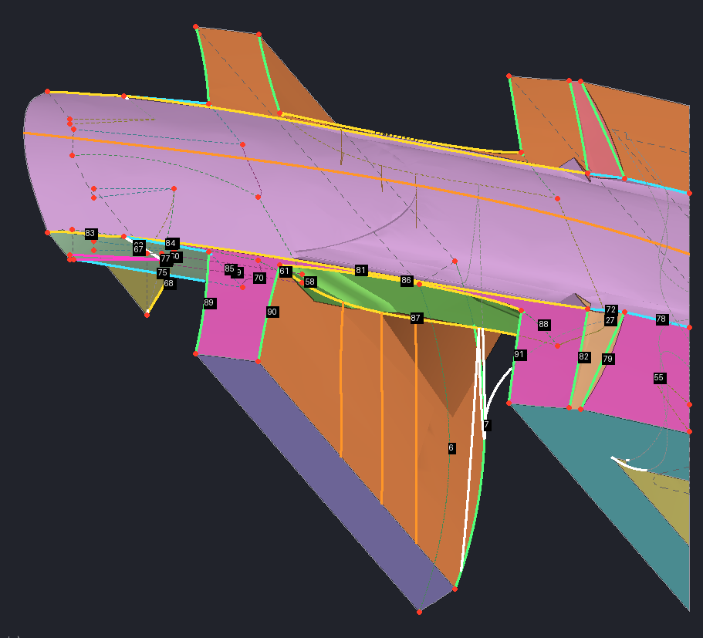
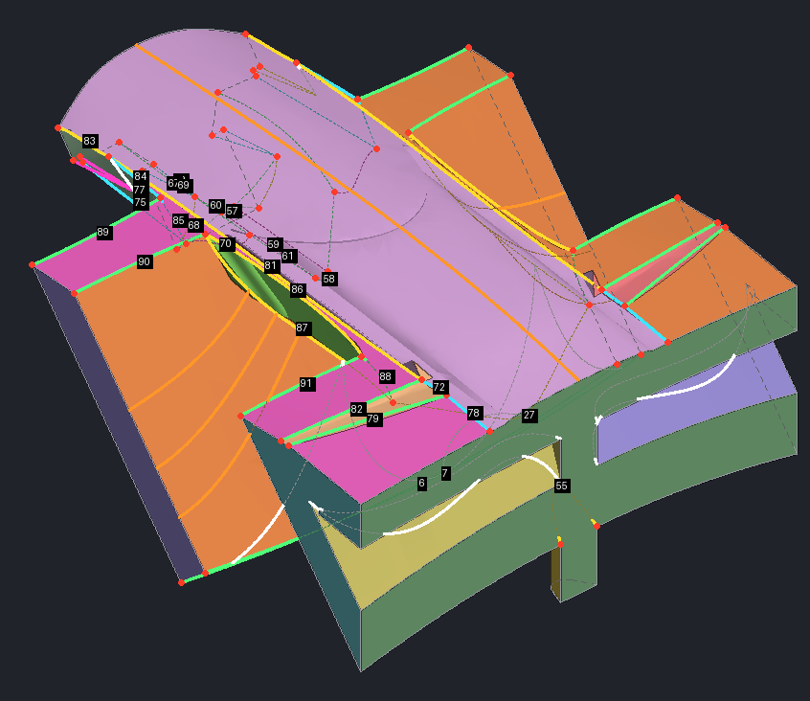
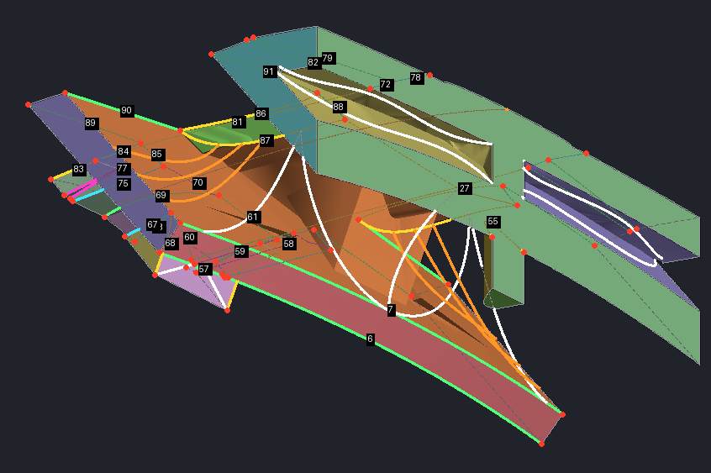
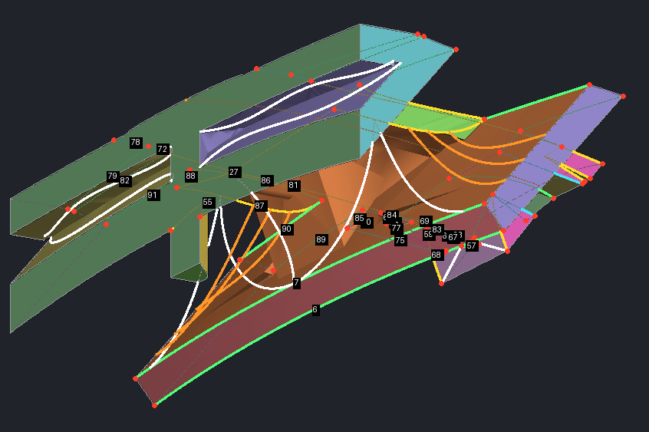
Step 8 – Split Lines and Guide Lines
The agent draws the lines that shape the new surfaces; the kit mirrors them to the other side
WHAT THE AGENT ADDS
Split lines (white) cut a face in two, so each piece is one simple surface.
Guide lines (orange) run inside a face; its new surface is pulled through them.
THIS EXAMPLE
7 split lines and 4 guide lines were written. One of each lies on the center line; the rest are mirrored, making 13 split lines and 7 guide lines in the wireframe.
RULES THAT KEEP IT BUILDABLE
A split line runs from one border of its face to another and cuts the border there; where it reaches a wall, it must end on a numbered corner.
Each piece a split makes faces one way.
Every line carries its reason in the line record.
The kit refuses a line farther off the original part than a set limit: 0.5 mm by default, raised to 10 mm here because this edit adds material.
Side view: thin orange guide lines run along the spine top and down the new flare; the surfaces pass through them.
From the rear and above: curved orange guides shape the flare sweeping down from the spine's side.
From the rear and below: on each side, two white split lines bound the lid that closes the slit.
The other side: the lid lines are mirrored, and orange guides shape the flare beside the spine.

Slide 14
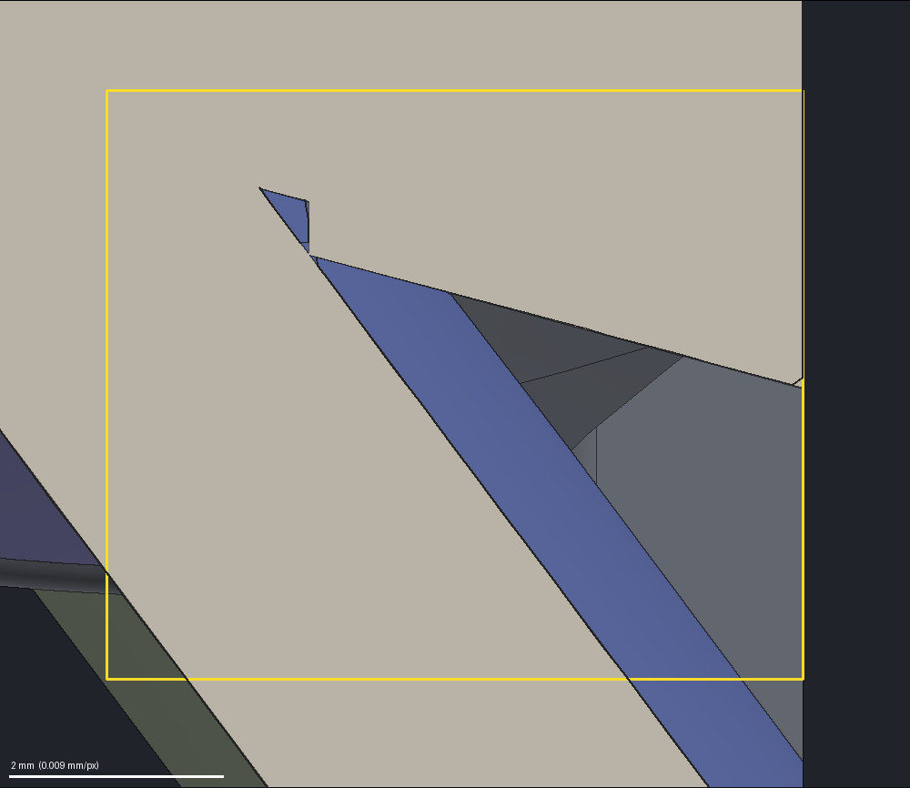
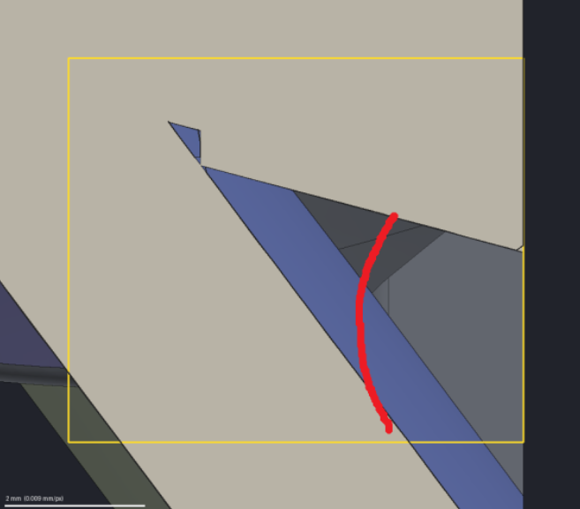
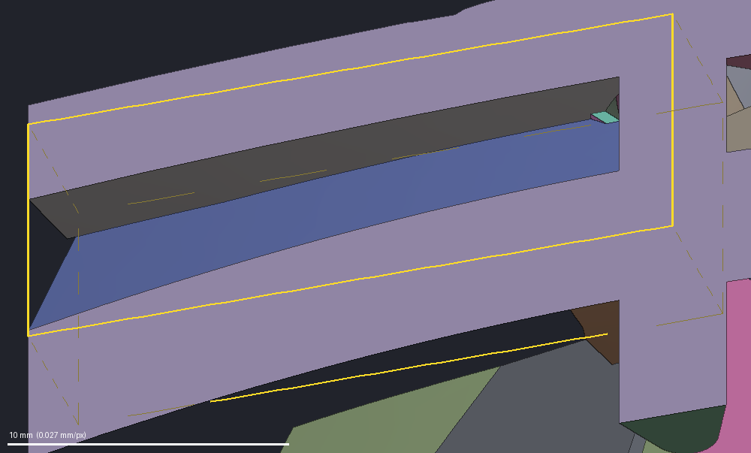
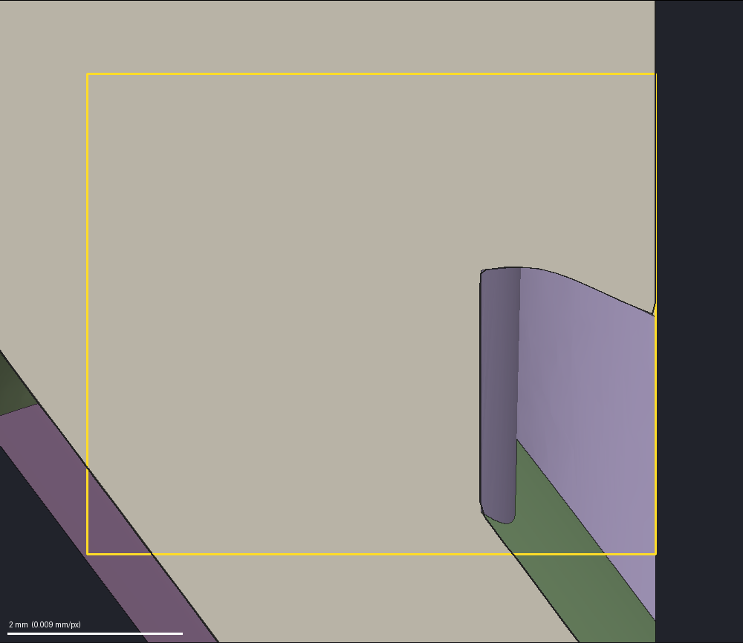
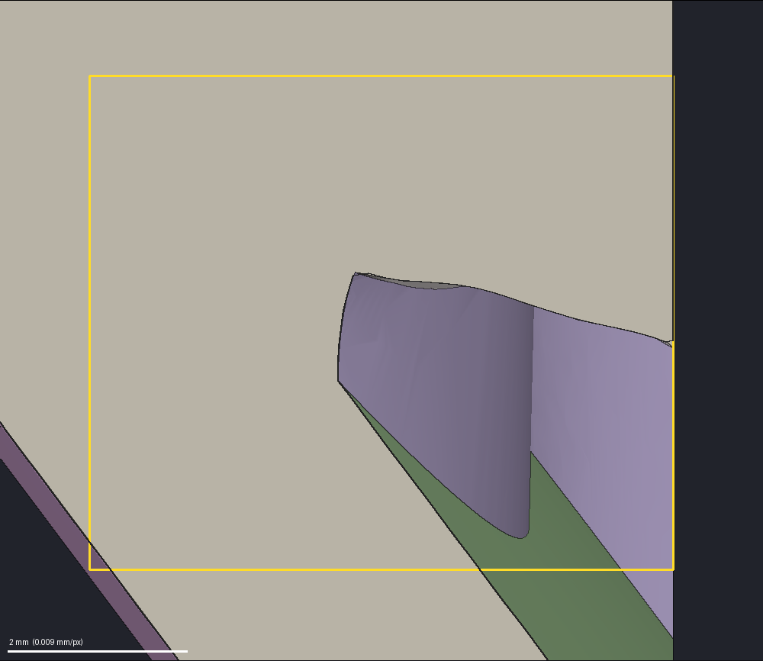
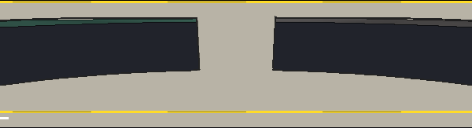
Example – Closing the Hairline Slit with Two Lines
The owner drew a line across the wedge; two split lines through its ends cut a lid out of one face
THE INSTRUCTION
Close the hairline slit between the plate and vane 2 with a single plane across the wedge, on the line the owner drew.
HOW THE WIREFRAME DOES IT
Step 4 made the plate's underside, the small step, the land, vane 2's top and the keel end one face.
Two split lines run across the part through the two ends of the drawn line: one along the plate, one along vane 2. Both end on wall corners.
The piece between them is the lid, a smooth fill that follows the owner's line. Everything in front of it, the wedge tip, the slit and the pocket, becomes solid.
The slot behind the lid stays open.
In these cuts, the yellow box only frames the area looked at.
Before: looking into the wedge between the plate and vane 2. Its two faces meet deep inside in a hairline.
Before, cut across the wedge: light gray is solid material; the open wedge narrows to a hairline at its tip.
The instruction: the owner's red line on that same cut marks where a lid should close the wedge.
After, cut just in front of the rear wall: the slot behind the lid stays open on both sides, as intended.
After, same cut and camera: solid material fills the wedge up to the lid on the owner's line.
After, cut closer to the side wall: no hairline gap remains here either.

Slide 15
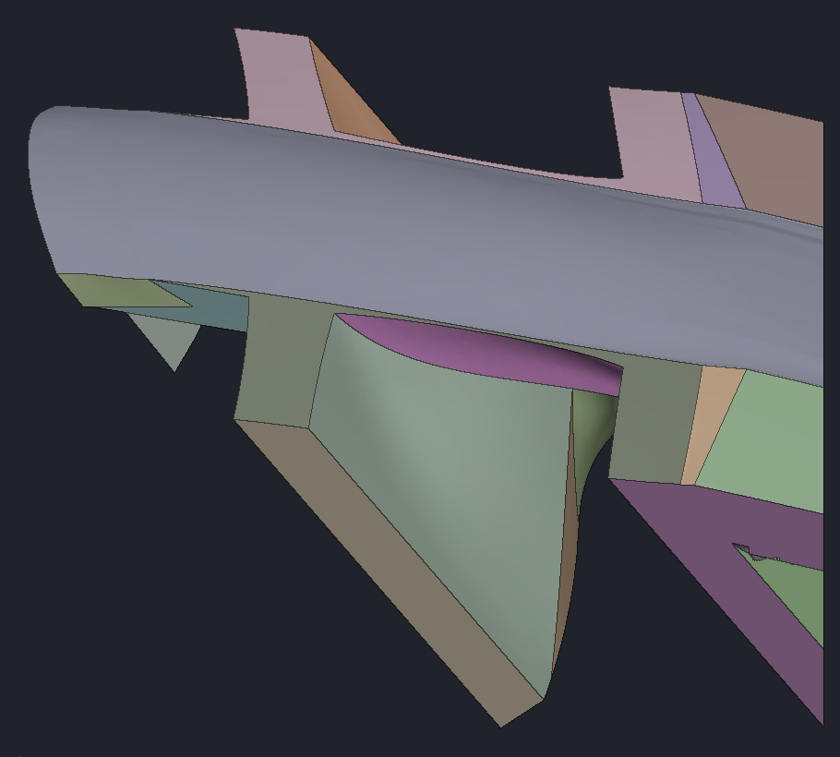
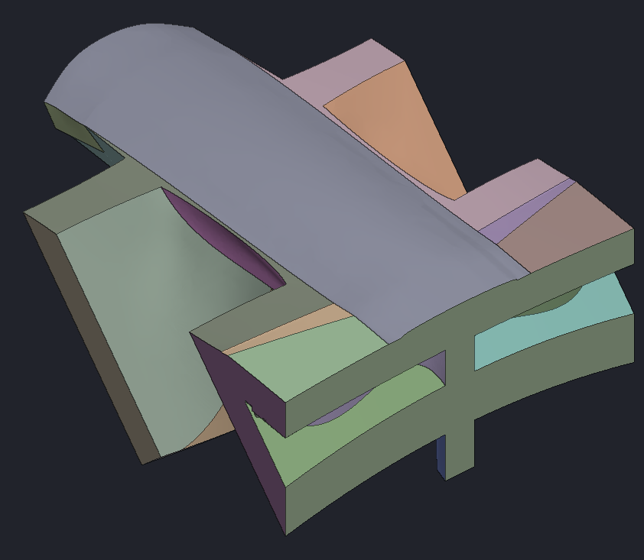




Steps 9 and 10 – Preview, Then Build the Piece
Each face gets the first surface that fits its edges; the faces are sewn into one closed solid
STEP 10 – THE SURFACE LADDER
The face's own original surface.
A plane, when its edges lie in one.
A NURBS fill through its edges and lines.
A Coons patch; if it folds, the NURBS fill again with its edges allowed up to 0.5 mm off; then a plate.
STEP 9 – PREVIEW
Before the full build, the kit runs the ladder on the wireframe and stops before sewing. The wireframe cannot be passed without a passing preview.
THE KIT CHECKS
A crossing between faces deeper than the 0.3 mm print tolerance, or a frame not exact at the walls, is refused. A face whose border crosses itself passes the build: it is listed, and refused at acceptance.
THIS EXAMPLE
Preview: 18 rebuilt faces spanned, none failed. Built: 50 faces = 12 kept on the original surface + 31 NURBS fills + 7 wall caps; the 18 rebuilt faces were cut into 31 by the 13 split lines. One closed solid with no gaps; the kit flags 4 faces whose borders cross themselves, and two strips took the relaxed fill (last slide).
The built piece from above: one closed solid, 50 faces, each in its own tint. The gray face is the spine top.
Side view: the large pale-green face is new fill, sweeping from the spine down onto the vane.
From the other end: the face with two slot openings is a wall cap, the body's own cut face, kept exactly.
From below at the other end: new curved faces now span the underside beneath the spine.
From the rear, the same cap nearly face-on: its outline is the section where the rear wall cut the body.
From below: smooth underside faces, and a flat cap where a wall cut through the spine.

Slide 16






Step 11 – Look at Every Rebuilt Face
Each rebuilt face of the piece alone, in two views under a side light
WHAT IT DOES
Each rebuilt face of 2 mm² or more is drawn in its own tint, its neighbors gray, from two angled views under a side light. Faces that keep their original surface, and wall caps, are drawn this way only when the build flags them.
A lump, ripple, crumple or fold shows as uneven shading.
Angled views, never square on: a bump hides when a face is seen straight on.
THE AGENT DECIDES
Whether each face is clean.
THE KIT CHECKS
A verdict on pictures that were not opened is refused.
THIS EXAMPLE
The accepted verdict rested on the quick look: whole-piece views and the original-against-piece check. These per-face pictures were drawn but not judged.
The spine top, the largest new face, tinted alone with its neighbors gray. It is one of the four flagged faces.
A new flare sweeping down from the spine toward vane 1, tinted alone; a lump would show as a spot.
Half of the new belly under the spine. A trial reviewer later recorded this underside as ragged and dented.
The lid closing the slit between the plate and vane 2, seen through the open slot behind it.
Vane 2's underside kept its original surface; it is drawn here only because the build flagged one of its edges.
Small faces too: this one is about 11 mm², framed to fill the picture.

Slide 17






Step 11 – The Original Against the Piece
Every original face is compared with the new piece: what was filled, what was removed
WHAT IT DOES
Every original face is sampled against the new piece. A face within 0.5 mm of the piece still lies on it.
THE AGENT DECIDES
Each changed area is named: changed by design (filled or reshaped on purpose) or a feature lost. Material removed needs a reason on record.
THIS EXAMPLE
Of 131 original faces, 67 still lie on the piece, 6 are off only in tiny spots, and 58 changed in 6 areas.
By design: the slot under the spine, and the hairline slit and the crown slit on both sides. One flaw: the keel's bottom edge near vane 2 lost up to 0.8 mm (last slide).
COLORS
Green: original and piece within 0.5 mm. Yellow: original only. Blue: piece only. In 3-D, yellow drawn over the gray piece lies inside new material; magenta outlines the old faces.
Cut through the old slot under the spine: yellow is original only, blue is piece only. The slot is now solid.
Crosswise cut just in front of the lid, wall end: the slit (yellow) is now solid. Blue tick: the lid.
Under the crown, a level cut seen from above: the small slit (yellow) is filled; blue is the new surface.
The slot in 3-D: old slot walls and vane 1's old top (yellow) lie inside the gray piece; nothing was cut.
The other side, same crosswise cut: the mirror of the picture above, the slit closed the same way.
The hairline slit in 3-D: the thin yellow wedge, the old gap, now lies inside the gray piece.

Slide 18



Step 13 – Trial in the Real Body
The piece is sewn to the body along the cut – no boolean joins them – and the result is checked
WHAT IT DOES
Each of the piece's 7 wall caps is matched to the body's cut face there; both copies are removed, and the rest is sewn along the shared edges. A boolean union is avoided because it fails on a piece like this one. The result is a trial copy of the whole body; the model of record is not touched.
THE KIT CHECKS
First, the piece must pass the CAD kernel's strict geometry check. This piece failed it, so the trial ran only as a look, under an override the owner approved.
One valid solid: 4,789 faces.
The seam: no face left over at the joint.
Protected openings unchanged: here, the slot behind the lid.
THIS EXAMPLE
Material added: 2,367 mm³, measured on the whole body's mesh; a second measurement of the section alone gives 2,364 mm³.
The rebuilt section in a trial copy of the whole housing, seen from above; the red box marks it.
The whole trial body from the side and above; the red box marks the section.
Looking toward the rear from in front: the spine crosses the vanes; a reviewer noted faint ripples at its far end.
From the side: the new fill runs from under the spine onto vane 1; a reviewer noted dimples at both ends.

Slide 19






Step 14 – Review and Accept
Cuts through the old and new bodies in the same places, then two reviewers, each with half the pictures
CUTS THROUGH OLD AND NEW
16 cuts through the old and the new body in the same places. Green: unchanged (within 0.15 mm). Yellow: old body only. Blue: new body only.
Outside the section every segment must be green. Here all 4 cuts outside it are: 243, 353, 1,180, 1,139 segments, none old only or new only.
TWO REVIEWERS
Two reviewer agents split the 24 pictures of the real body, 12 each, and report what they see. Both passed their half with no blockers; one recorded 3 flaws (last slide).
ACCEPTANCE
The owner decides from the pictures. An accepted trial becomes the model of record as it is; nothing is rebuilt. The kit refuses to accept a piece with a face whose border crosses itself.
Lengthwise cut just outside the section: all 1,139 segments are green, so the old and new bodies agree there.
Through the vanes: the new flare from the spine adds material on one vane face, straight before (yellow), curved now (blue).
Inside the section, at right: the slit's tip (yellow) is solid up to the lid (blue tick). Vane 1's face shifts slightly.
Across the spine: the old slot under it (yellow) is now solid, and flared sides (blue) sweep down onto vane 1.
Across the spine at another place: the underside now drops to a deep V keel (blue), below the old stepped one (yellow).
Next to the center: the old slot walls under the spine (yellow zigzag) give way to one smooth curve (blue).

